Slide 1
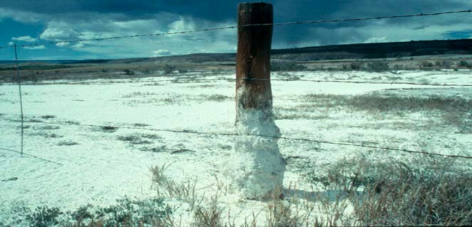
Salt Deposits
Soil Salinity
012-10991 r1.04

Slide 2
Salt Deposits
Soil Salinity
012-10756 r1.04

Slide 3
Soil Salinity
Introduction
Each page of this lab that contains the symbol
should be inserted into your journal. After completing a lab page with the snapshot symbol, tap (in the upper right hand corner) to insert the page into your journal.
Journals and Snapshots
The Snapshot button is used to capture the screen.
The Journal is where snapshots are stored and viewed.
The Share button is used to export or print your journal to turn in your work.
Note: You may want to take a
snapshot of the first page of
this lab as a cover page for
your journal.

Slide 4
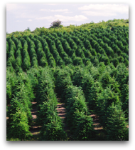
Soil Salinity
Lab Challenge
How healthy is your soil?
What is soil salinity?
How does soil salinity impact the plants it supports?
What causes changes in soil salinity?

Slide 5
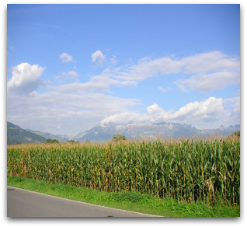
Soil Salinity
Background
Soil salinity is a measurement of the water-soluble salts present in soil.
Salts are a widespread and natural component of all soils.
However, an increase in salt concentration will adversely affect the growth of agricultural crops, decrease productivity, and threaten the balance of the earth's soil layer.

Slide 6
Soil Salinity
Self-check
Soil containing any type of salt cannot support plant growth.
true
false
Notes:
L6 – Text box
[The best choice is…]

Slide 7
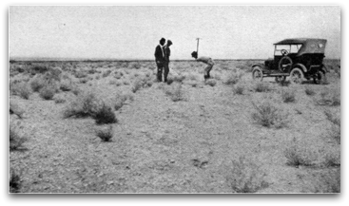
Soil Salinity
...Background
The degree of crop damage and corrective action depends on the concentration and type of salt accumulated. Soil that is high in soluble salts is referred to as saline soil.

Slide 8
Soil Salinity
...Background
As minerals in soils weather, they release salts. These salts are leached out of the soil by ground or surface water in areas with sufficient precipitation.
Salts are also deposited via dust and precipitation. In dry regions salts may accumulate, leading to naturally saline soils.
The distribution of salt in soils is ultimately determined by the geology of the land. Ocean water can affect the salinity of soils in coastal regions.

Slide 9
Soil Salinity
Self-check
How do different types of geologic terrain affect the salinity of surrounding soils?
Notes:
L456 – Text box
[Minerals, dust and precipitation and ocean water all release…]

Slide 10
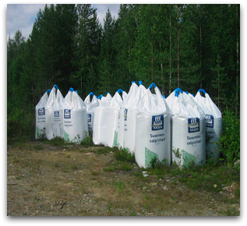
Soil Salinity
...Background
Most of the salts present in irrigation water contain magnesium, potassium, sulfates, and chlorides, in addition to sodium salts.
Additionally, fertilizers contain many different kinds of salts, including nitrogen and calcium salts. Over-fertilizing and improper irrigation techniques aggravate pre-existing soil salinity conditions.

Slide 11
Soil Salinity
Self-check
Explain how the contents of fertilizers can affect soil salinity.
Notes:
L456 – Text box
[Fertilizers contain…]
[which affect soil salinity.]

Slide 12
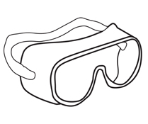
Radiation Energy Transfer
Safety
Follow all standard laboratory safety procedures.
Wear safety glasses.
Keep water away from sensitive electronic equipment.
Wash your hands after handling soils.

Slide 13
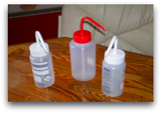
Soil Salinity
Materials and Equipment
Collect all of these materials for your group.
Materials shared across the class.
Conductivity sensor
Digging tool
Stirring rod
Beaker, 100-mL (4)
Plastic zip lock bag (3)
Graduated cylinder, 100-mL
Wash bottle containing deionized or distilled water
Waste container
Permanent marker
Paper towels

Slide 14
Soil Salinity
Sequencing Challenge
The steps to the left are part of the procedure for this lab activity. They are not in the right order. Determine the correct sequence of the steps, then take a snapshot of this page.
A. Use the sensor to measure the conductivity of the soil sample.
B. Plug the conductivity sensor into your SPARK Science Learning System.
C. Identify the prevalent organisms and plant types at the collection site.
D. Crush a dry soil sample into a fine dust and mix with water.
Notes:
L6 – Text box
[The correct sequence of steps is…]

Slide 15
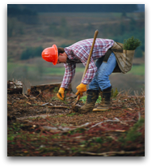
Soil Salinity
Setup
Using the digging tool, gather 3 soil samples from different locations. If possible, find soils that differ in appearance, composition, and in the type of plants growing nearby.
Use the next three pages to record field notes about each of your soil samples.
Note: Give each sample a label, describe its appearance, and describe what kinds of plants are growing nearby.
Take a snapshot of each page of your field notes.

Slide 16
Soil Salinity
Notes:
L14 – Text box
Col 1: [Soil Sample 1: (snapshot this page when complete), Location:, Date/Time Collected:, Appearance/Composition:, Description of Nearby Plants:]

Slide 17
Soil Salinity
Notes:
L14 – Text box
Col 1: [Soil Sample 2: (snapshot this page when complete), Location:, Date/Time Collected:, Appearance/Composition:, Description of Nearby Plants:]

Slide 18
Soil Salinity
Notes:
L14 – Text box
Col 1: [Soil Sample 3: (snapshot this page when complete), Location:, Date/Time Collected:, Appearance/Composition:, Description of Nearby Plants:]

Slide 19
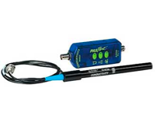
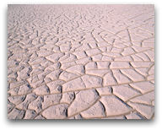
Soil Salinity
Setup
Crush each of the soil samples into as fine a dust as possible. Remove any rocks, sticks, etc.
Plug the conductivity sensor into your data collection system. The values from this sensor indicate the concentration of salts in a soil sample.
You may need to set the conductivity sensor to the appropriate sensitivity.

Slide 20
Soil Salinity
Self-Check
Q1: Why is it important to set the sensitivity of the conductivity sensor to suit the sample you are testing?
Notes:
L456 – Text box
[It is important to set the sensitivity of the conductivity sensor because…]

Slide 21
Soil Salinity
Setup
Label 3 of the beakers as "Sample 1," "Sample 2," and "Sample 3."
Add about 4 tablespoons of each of your soil samples into the corresponding labeled beaker.
Add about 4 tablespoons of distilled water into each beaker.
Mix the soil and water thoroughly in each beaker. Clean your stirring rod between each beaker to avoid cross-contamination.
Allow the muddy mixtures to sit for approximately 5 minutes.

Slide 22
Soil Salinity
Procedure
Rinse the conductivity sensor with distilled water, then slowly swirl it in the Soil 1 solution.
Tap to activate the sensor display.
Once the conductivity value stabilizes, tap . If necessary, adjust the sensitivity of the sensor.
Record conductivity value in the box to the right.
Repeat steps 1-4 using Soil Samples 2 and 3. Always rinse the sensor between each trial.
Notes:
L3 – a digits display with Conductivity
L6 – Text box
[Muestra 1 =]
[Muestra 2 =]
[Muestra 3 =]

Slide 23
Soil Salinity
Procedure
6. Rinse the conductivity sensor with distilled water.
7. Pour 50 mL of distilled water into the fourth beaker. Then place the sensor into the water.
8. Tap to activate the sensor display.
9. Once the conductivity value stabilizes, tap .
10. Record the conductivity value for the distilled water in the box to the right.
11. Take a snapshot of this page.
12. Save your work then follow your teacher’s instructions for cleaning up.
Notes:
L3 – Digits, Conductivity
L6 – Text box
[Distilled Water Conductivity =] la conductividad del agua destilada

Slide 24
Soil Salinity
Analysis
1. What factors (variables) did you attempt to control (keep the same) across all 3 trials?
Notes:
L456 – Text box
[The variables I attempted to control were…]
Las variables que he tratado de control se ...

Slide 25
Soil Salinity
Analysis
What was the independent variable (the variable you chose to change)?
What was the dependent variable (the variable that changed under the different experimental conditions in the 3 trials)?
Notes:
L456 – Text box
[2. The independent variable was…]
[3. The dependent variable was…]

Slide 26
Soil Salinity
Analysis
4. Why did you add water to the soil samples before testing them?
Notes:
L456 – Text box
[I added water to the soil samples in order to…]

Slide 27
Soil Salinity
Analysis
5. Which of the three soil solutions had the highest conductivity? Explain why it might be higher than the other two samples. Recall information describing the location of the sample.
Notes:
L456 – Text box
[The soil that had the highest conductivity was…]
[because…]

Slide 28
Soil Salinity
Analysis
6. Which of the three soil solutions had the lowest conductivity? Explain why it might be lower than the other two samples. Recall information describing the location of the sample.
Notes:
L456 – Text box
[The soil that had the lowest conductivity was…]
[because…]

Slide 29
Soil Salinity
Synthesis
Why was distilled water tested? Why is this important in scientific research?
Notes:
L456 – Text box
[Distilled water was tested because…]
[This is important because…]

Slide 30
Soil Salinity
Synthesis
What factors may have interfered with the accuracy of your conductivity measurements?
Notes:
L456 – Text box
[The following factors may have interfered with the conductivity results…]

Slide 31
Soil Salinity
Synthesis
How would the results of the experiment change if the water and soil mixtures were allowed to sit overnight prior to testing? Would the conductivity increase or decrease? Why?
Notes:
L456 – Text box
[If the soils sat overnight, the conductivity would…]
[because…]

Slide 32
Soil Salinity
Multiple Choice
A salt is __________.
a solid that does not dissolve in water
a solid that dissolves in water, with the molecules remaining intact
a solid that dissolves in water, dissociating into positive and negative ions
a chemical that is highly toxic at very small concentrations
both C and D
None of the above.
Notes:
L6 – Text box
[The best choice is…]

Slide 33
Soil Salinity
Multiple Choice
An ion is __________.
the smallest unit of matter
an element with a unique atomic number
an atom with a net electrical charge
an element having the same atomic number but a different mass number
another name for a positively charged subatomic particle
Notes:
L6 – Text box
[The best choice is…]

Slide 34
Soil Salinity
Multiple Choice
Salinization refers to __________.
release of toxic metals such as Al, Fe, Mn, and Ni
deficiencies of micronutrients such as B, Fe, and Mn
release of calcium carbonate
increase in salts
None of the above.
Notes:
L6 – Text box
[The best choice is…]

Slide 35
Soil Salinity
Congratulations!
You have completed the lab.
Please remember to follow your teacher's instructions for cleaning-up and submitting your lab.
Notes:
Color scheme (RGB values)
biology 121, 173, 54
chemistry 0 176, 216
physics 0, 102, 204
earth 204, 102, 0
middle 153, 102, 153
elementary 255, 51, 0

Slide 36
Soil Salinity
References
All images were taken from PASCO documentation, public domain clip art, or Wikimedia Foundation Commons:
http://commons.wikimedia.org/wiki/File:Salinity.jpg
http://commons.wikimedia.org/wiki/File:Helianthus_annuus_exposed_2004-05-22.jpg
http://commons.wikimedia.org/wiki/File:Field,_corn,_Liechtenstein,_Mountains,_Alps,_Vaduz,_sky,_clouds,_landscape.jpg
http://commons.wikimedia.org/wiki/File:Forest_fertilizer.JPG http://commons.wikimedia.org/wiki/File:Soil_survey_1923.jpg
http://commons.wikimedia.org/wiki/File:Washbottles.JPG
http://www.freeclipartnow.com/office/paper-shredder.jpg.html

