Slide 1
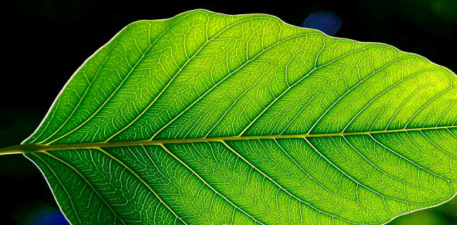
Transpiration
012-10977 r1.04

Slide 2
Transpiration
Introduction
Each page of this lab that contains the symbol
Should be inserted into your journal. After completing a lab page with the snapshot symbol, tap (in the upper right hand corner) to insert the page into your journal.
Journals and Snapshots
The Snapshot button is used to capture the screen.
The Journal is where snapshots are stored and viewed.
The Share button is used to export or print your journal to turn in your work.
Note: You may want to take a
snapshot of the first page of
this lab as a cover page for
your journal.

Slide 3
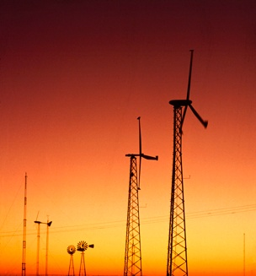
Transpiration
Lab Challenges
What is transpiration?
Do environmental factors, such as wind, have an effect on transpiration?

Slide 4
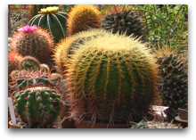
Transpiration
Background
Transpiration is the evaporation of water from the surface of a plant. This occurs through the stomata on the underside of the leaves.
Stomates open and close to regulate the amount of water lost through transpiration.
Plants have adaptations, such as waxy cuticles, or modified leaf shapes, that help prevent water loss.

Slide 5
Transpiration
Self Check
Plants are able to prevent water lost through transpiration by doing the following:
closing stomates
having a waxy cuticle
having a modified leaf shape
just saying NO
A, B and C are correct
none of the above
This image is a reminder to
tap to take a snapshot
of the page after you have
entered your response.
Notes:
L6 – Text Box
[The correct choice is…]

Slide 6
Transpiration
...Background
Water moves through a plant in the xylem tissue.
The transport of water through the xylem tissue is controlled by differences in the concentration of water molecules (water potential).
Water evaporates from the open stomata of a leaf because the concentration of water molecules in the air is less than that inside the moist leaf.
There is a lower concentration of water in the leaf than in the xylem. So water moves from the xylem to the leaf.
This leaves a lower concentration of water in the xylem, so water moves from the roots to the xylem.
The low concentration of water in the roots draws water from the soil, into the roots.

Slide 7
Transpiration
Self Check
Water moves through which of the following tissues in a plant?
xylem
phloem
cuticle
ground
parenchyma
Notes:
L6 – Text Box
[The correct choice is…]

Slide 8
Transpiration
Safety
Follow all common lab safety procedures.
Be careful as you use the knife or razor blade to trim the plant stem.
Do not let the barometer get wet.

Slide 9
Transpiration
Materials and Equipment
Collect all of these materials before beginning the lab.
Barometer
Sensor Extension Cable
Large Base and Support Rod
Utility Clamp
3-Finger Clamp
Pipette
Plastic tubing, ~50cm
Knife or Razor Blade
Fan
Bowl
Glycerin, 1 mL
Petroleum Jelly, 2-3 g
Plant Seedling
Water, 1 L

Slide 10
Transpiration
Sequencing Challenge
The steps to the left are part of the procedure for this lab activity. They are not in the right order. Determine the correct sequence of the steps, then take a snapshot of this page.
A. Record data in still air.
B. Set up all of your equipment.
C. Record data in moving air.
D. Analyze the data and determine if wind causes changes in the rate of transpiration.
Notes:
L6 – Text Box
[The correct sequence is…]

Slide 11
Transpiration
Setup: Still Air
Q1: Why do you think it is important to keep the plant stem under water after you cut it?
Attach the barometer to a sensor extension cable and connect it to the SPARK Science Learning System.
Put a drop of glycerin on the barbed end of the quick-release connector and insert the barb into one end of the plastic tubing.
Use a knife or razor blade to cut the stem of a plant, 2-3 cm above the soil. Immediately immerse the cut end into a bowl of water.
Trim the freshly cut end to a 45 degree angle, keeping it submerged under water the entire time.
Notes:
L6 – Text Box
[It is important to keep the stem underwater so that…]

Slide 12
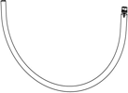
Transpiration
Setup: Still Air
Bend the piece of plastic tubing into a "U-shape" and use a pipette to fill the tubing with water.
Submerge the tubing in the bowl of water and insert the cut end of the plant stem into the open end of the tubing.
Note: The plant stem should fit relatively snug in the tube. Avoid creating any air bubbles in the tubing.
Raise the tubing and plant out of the water keeping the "U-shape". Adjust the level of the tubing so there is a 2-3 cm gap beneath the connector end. Water will spill out of the open end of the tubing.
Note: Make sure water always stays in contact with the plant.

Slide 13
Transpiration
...Setup: Still Air
The sensor is mounted above the cut end of the stem.
Spread a thick amount of petroleum jelly around the base of the plant stem to create a seal between the edge of the tubing and the plant.
Note: If water is able to leak out, it is not sealed.
Mount the barometer sensor and U-shaped tubing to the support rod as shown in the picture.
Air bubble
The cut end of the stem is mounted 1 to 2 inches below the sensor.

Slide 14
Transpiration
...Setup: Still Air
Q2: Why do you need to seal the tube with petroleum jelly?
What would happen if the plant stem came in contact with the petroleum jelly?
Align the quick release connector in the tubing to the pressure port of the sensor. Push the connector into the port and twist until it "clicks". Make sure no water enters the sensor by maintaining a 2-3 cm gap between the sensor and the water level.
Answer the question and continue to the next page.
Notes:
L6 – Text Box
[You need to seal the tubing with petroleum jelly because…]
[If it came in contact with the stem…]

Slide 15
Transpiration
Q3: What will happen to the pressure inside the tubing as transpiration occurs?
Draw your prediction on the graph provided.*
*To Draw a Prediction:
1. Tap to open the tool palette.
2. Tap then use your finger to draw your prediction.
3. Tap when finished.
4. If you make a mistake, tap to clear your prediction.

Slide 16
Transpiration
Collect Data: Still Air
Tap to start collecting data.
Collect data for 600 seconds and tap to stop recording.
Restore pressure in the tubing to its original value by carefully removing and reattaching the quick release connector.

Slide 17
Transpiration
Q4: Why is it necessary to restore pressure in the tubing before starting the next trial?
Q5: What is the controlled variable in this experiment?
Notes:
L3 – Text Box
[It is necessary to restore pressure because…]
L6 – Text Box
[The controlled variable is…]

Slide 18
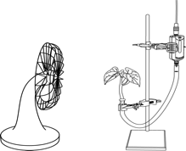
Transpiration
Setup: Moving Air
Q6: What environmental condition is the fan simulating?
Leave your transpiration apparatus set up as before.
Place a fan 1 m from the plant.
Turn the fan on low so a gentle breeze blows over the plant.
Notes:
L6 – Text Box
[The fan is simulating…]

Slide 19
Transpiration
Q7: What will happen to the pressure in the tubing when the fan blows on the plant?
Draw your prediction in the graph.*
*To Draw a Prediction:
1. Tap to open the tool palette.
2. Tap then use your finger to draw your prediction.
3. Tap when finished.
4. If you make a mistake, tap to clear your prediction.

Slide 20
Transpiration
Collect Data:
Moving Air
Tap to start collecting data.
Collect data for 600 seconds and tap to stop recording.
When you are finished with data collection, continue to the next page.

Slide 21
Transpiration
Data Analysis
Scale your graph to optimize your display.*
*To Scale a Graph:
1. Tap to open the tool palette.
2. Tap to scale the graph.
3. If you need to manually scale the graph, touch one of the numbers labeling an axis and drag it up or down.

Slide 22
Transpiration
Data Analysis
Determine initial pressure, final pressure and change in pressure* for each run.
Note: Enter these values on the next page.
*To Find the Difference Between Two Data Points:
Tap to open the tools palette.
Tap and then tap two points on the data run.
Adjust using both buttons and then tap .
Tap to display the differences.

Slide 23
Transpiration
Data Analysis
Record initial pressure and final pressure for each run in the table.
*To Enter Data into a Table:
1. Tap to open the tool palette.
2. Tap then tap a cell in the data table to highlight it in yellow.
3. Tap to open the Keyboard screen.
Notes:
L1245 – Table
Col 1: [Condition: Still Air, Wind]
Col 2: [Initial Pressure (hPa)]
Col 3: [Final Pressure (hPa)]

Slide 24
Transpiration
Data Analysis
Calculate the rate of transpiration for each run.
Hint: Change in pressure/ change in time
*To Enter Data into a Table:
1. Tap to open the tool palette.
2. Tap then tap a cell in the data table to highlight it in yellow.
3. Tap to open the Keyboard screen.
Notes:
L1245 – Table
Col 1: [Condition: Still Air, Wind]
Col 2: [Initial Pressure (hPa)]
Col 3: [Final Pressure (hPa)]
Col 4: [Rate of Transpiration (hPa/s)

Slide 25
Transpiration
Analysis
Does a decrease in pressure in the tubing correspond to more or less water being lost through the plant's stomata?
Notes:
L45 – Text Box
[A decrease in the pressure in the tubing means…]

Slide 26
Transpiration
Analysis
Explain how the fan affects the rate of transpiration. What natural phenomenon does this mimic?
Notes:
L4 – Text Box
[The fan affects the rate of transpiration…]
[It mimics…]

Slide 27
Transpiration
Synthesis
Describe some adaptations that enable plants to minimize water loss from their leaves.
Notes:
L45 – Text Box
[Some adaptations that plants have to reduce water loss are…]

Slide 28
Transpiration
Synthesis
Would you expect all plant species to have the same rate of transpiration under similar environmental conditions? Explain your answer.
Notes:
L45 – Text Box
[In the same environmental conditions, different plants species would…]

Slide 29
Transpiration
Synthesis
Do you think that leaves or stems are more important in the process of evaporation through transpiration? Explain your answer.
Notes:
L45 – Text Box
[_______________ are more important in transpiration because…]

Slide 30
Transpiration
Synthesis
Would the transpiration rate in a conifer leaf (needle) be higher or lower than that of a deciduous (broad) leaf? Explain your answer.
Notes:
L45 – Text Box
[The transpiration rate would be greater in a _____________ leaf, because…]

Slide 31
Transpiration
Synthesis
What do you think the data would look like if you removed the leaves from the plant prior to collecting the data? How does this relate to what you know about transpiration?
Notes:
L456 – Text Box
[If you removed the leaves from the plant prior to the experiment, transpiration would be _________ because…]

Slide 32
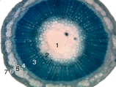
Transpiration
Multiple Choice
Which of the following describes the fate of most of the water taken up by a plant?
It is used as a solvent.
It is used as a hydrogen source in photosynthesis.
It is lost during transpiration.
It makes cell elongation possible.
Notes:
L6 – Text Box
[The correct choice is…]

Slide 33
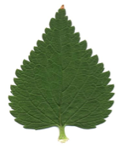
Transpiration
Multiple Choice
In a plant, where does the majority of transpiration take place?
roots
leaves
stems
all parts of the plant equally
Notes:
L6 – Text Box
[The correct choice is…]

Slide 34
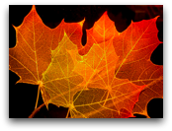
Transpiration
Multiple Choice
Most transpiration occurs through the:
stomata.
epidermis.
cuticle.
phloem.
Notes:
L6 – Text Box
[The correct choice is…]

Slide 35
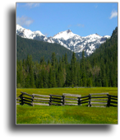
Transpiration
Multiple Choice
All of the following can affect transpiration except:
temperature
humidity
wind
leaf color
Notes:
L6 – Text Box
[The correct choice is…]

Slide 36
Transpiration
Congratulations!
You have completed the lab.
Please remember to follow your teacher's instructions for cleaning-up and submitting your lab.
Notes:
Color scheme (RGB values)
biology 121, 173, 54
chemistry 0 176, 216
physics 0, 102, 204
earth 204, 102, 0
middle 153, 102, 153
elementary 255, 51, 0

Slide 37
Transpiration
References
Images are taken from PASCO documentation, public domain clip art, or Wikimedia Foundation Commons.
http://pdphoto.org/PictureDetail.php?mat=pdef&pg=5528
http://www.openstockphotography.org/image-licensing/wind/USDA_windmills.jpg
http://commons.wikimedia.org/wiki/File:A_CDP_4.JPG
http://commons.wikimedia.org/wiki/File:Stem-histology-cross-section-tag.svg
http://commons.wikimedia.org/wiki/File:Lamium_album_scan.jpg
http://commons.wikimedia.org/wiki/Image:Lassen_meadow_caldera.jpg
http://www.flickr.com/photos/jurvetson/1575475/

