Slide 1
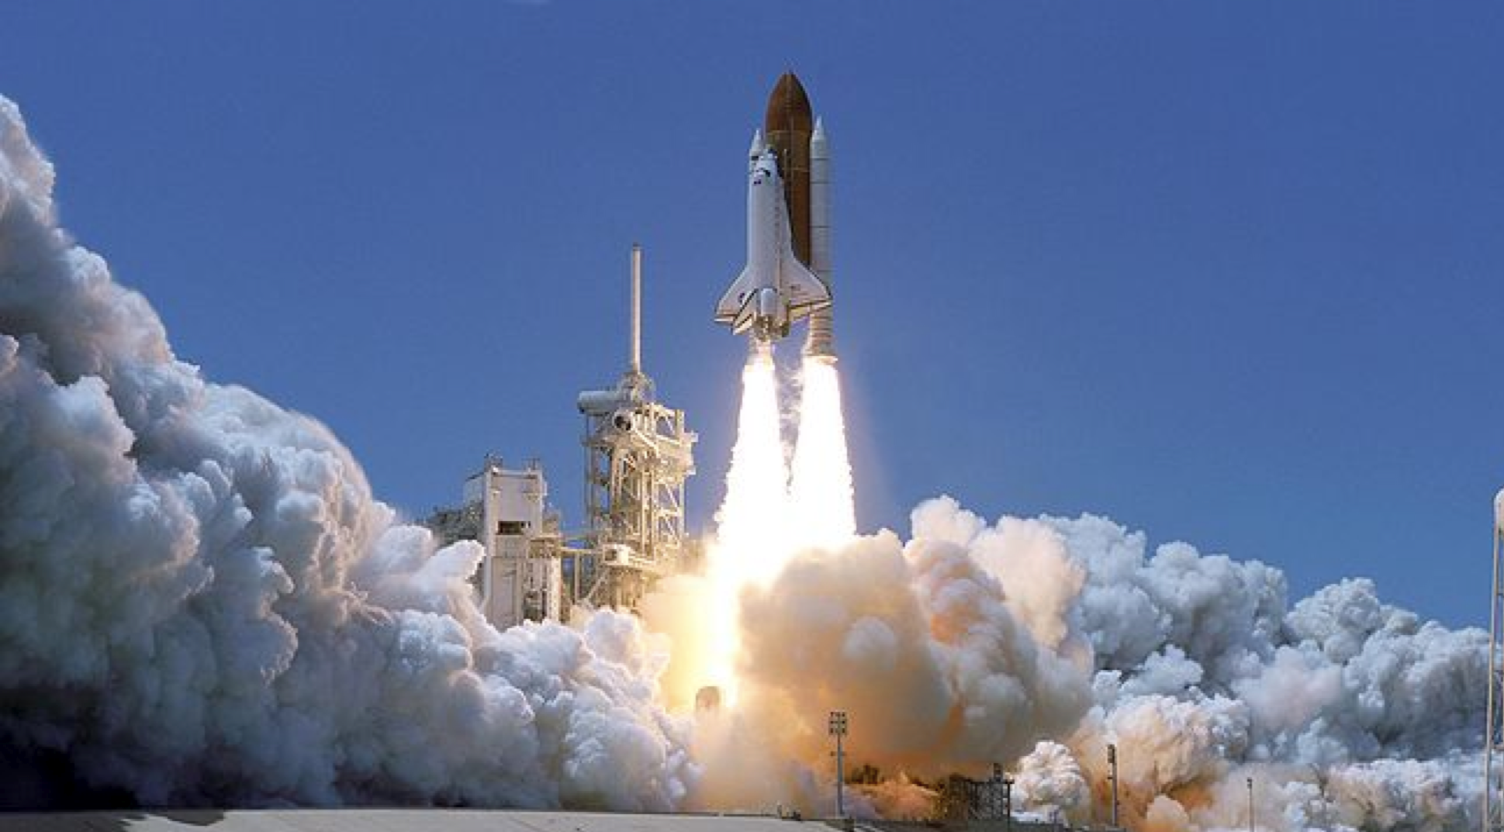
Newton’s First Law
012-10778 r1.04

Slide 2
Newton’s First Law
Introduction
Each page of this lab that contains the symbol
should be inserted into your journal. After completing a lab page with the snapshot symbol, tap (in the upper right corner) to insert the page into your journal.
Journals and Snapshots
The Snapshot button is used to capture the screen.
The Journal is where snapshots are stored and viewed.
The Share button is used to export or print your journal to turn in your work.
Note: You may want to take a
snapshot of the first page of
this lab as a cover page for
your journal.

Slide 3
Newton’s First Law
Lab Challenge
What factors affect the motion of objects? Aristotle (384 BC to 322 BC) believed that the natural state of an object was to be at rest and therefore that all objects in motion will eventually come to a stop. Is this view correct?
Our goal will be to investigate the causes of changing motion in order to determine the "rules" underlying objects in motion.

Slide 4
Newton’s First Law
Background
There was much argument between early philosophers and scientists regarding the motion of objects. It wasn't until the 17th century when Sir Isaac Newton formalized his three laws of motion.
The first law of motion: An object will maintain its state of rest or uniform motion unless acted upon by an external unbalanced force.
This became known as the law of inertia.

Slide 5
Newton’s First Law
...Background
Newton's 1st Law indicates that an object traveling with constant velocity will maintain that constant velocity unless otherwise acted upon by a net force. In addition, objects at rest (zero velocity) will stay at rest unless otherwise acted upon by a net force.
In other words, if the net force on an object is zero, its acceleration is also zero. We will investigate this concept by exploring the measured velocities associated with several different types of motion of a cart.

Slide 6
Newton’s First Law
Self-Check
What will happen to an object at rest if no force is applied?
Begin to accelerate
Remain at rest
Unknown
Disappear
Notes:
L6-Text Box
[The best choice is…]

Slide 7
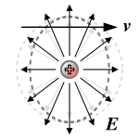
Newton’s First Law
Self-Check
What is required for an object to maintain motion at a constant velocity?
Large net force
No net force
Small net force
Negative net force
Notes:
L6-Text Box
[The best choice is…]

Slide 8
Newton’s First Law
Self-Check
3. What will happen to an object if there is a constant net force applied to it?
Notes:
L4,5,6-Text Box
[If a constant net force is applied…]

Slide 9
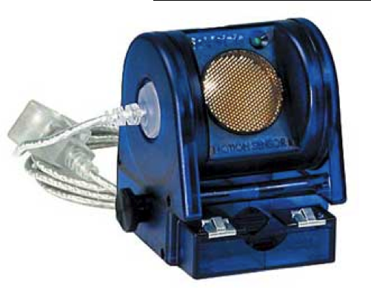
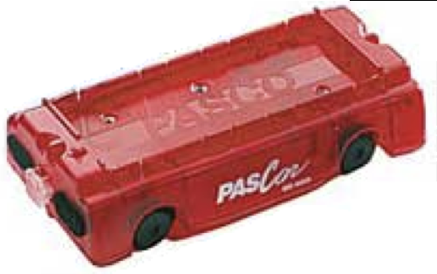
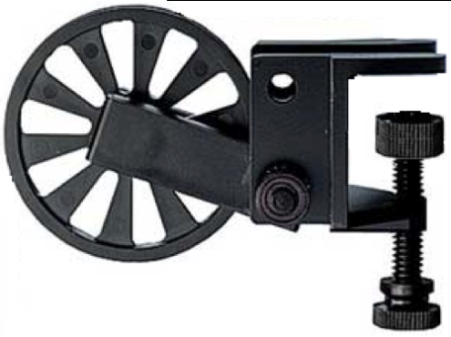
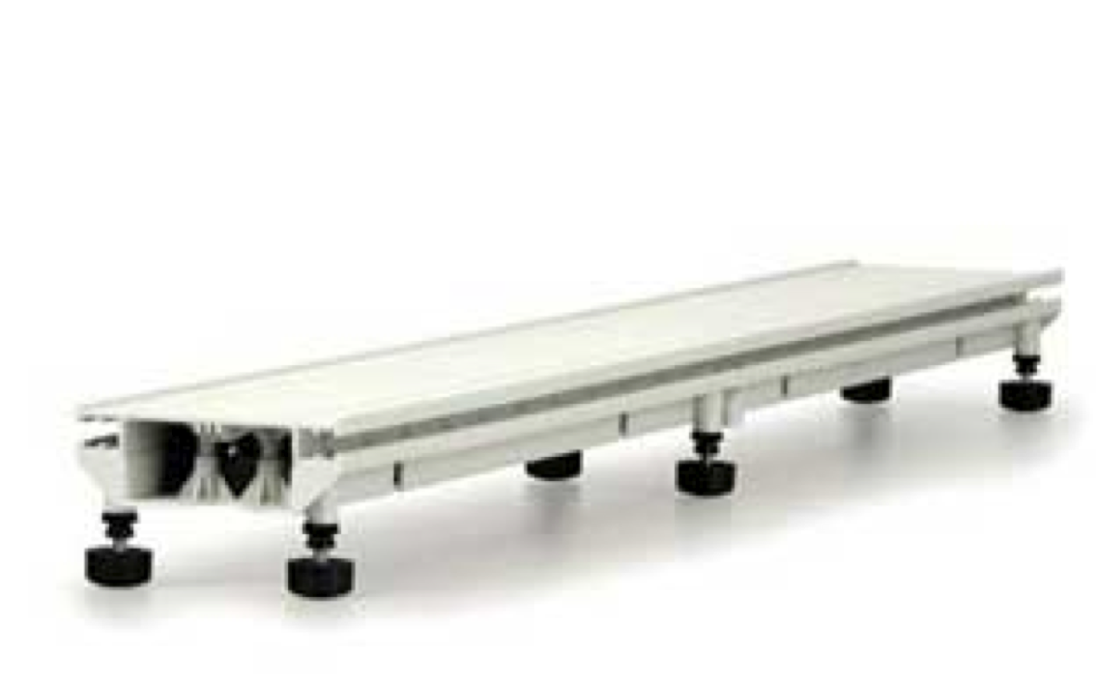
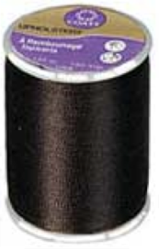
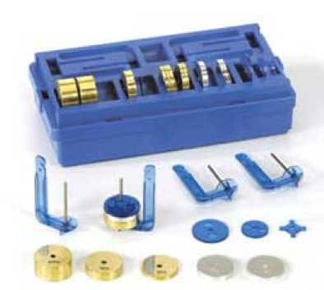
Newton’s First Law
Materials and Equipment
Collect all of these materials before beginning the lab.
Motion sensor
Dynamics cart
Super pulley with clamp
String
Mass and hanger set
Dynamics track w/feet

Slide 10
Newton’s First Law
Sequencing Challenge
The steps to the left are part of the procedure for this lab activity. They are not in the right order. Determine the correct sequence of the steps, then take a snapshot of this page.
A. Measure the velocity of a cart as a hanging mass acts on the cart.
B. Measure the velocity of a cart at rest on a flat track.
C. Use velocity data to determine if any net forces are acting on the cart.
D. Setup the dynamics track with super pulley at one end and the motion detector at the opposite end.
Notes:
L6-Text Box
[The correct sequence of steps is…]

Slide 11
Newton’s First Law
Setup
Set the dynamics track onto the lab table with one end of the track aligned with the edge of the lab table (or slightly hanging over the edge).
Attach the super pulley with clamp to the end of the track near the edge of the table, centered with the length of the track.
Attach the Motion Sensor to the opposite end of the track with the face of the sensor pointed toward the super pulley, and then connect the sensor to the data collection system.

Slide 12
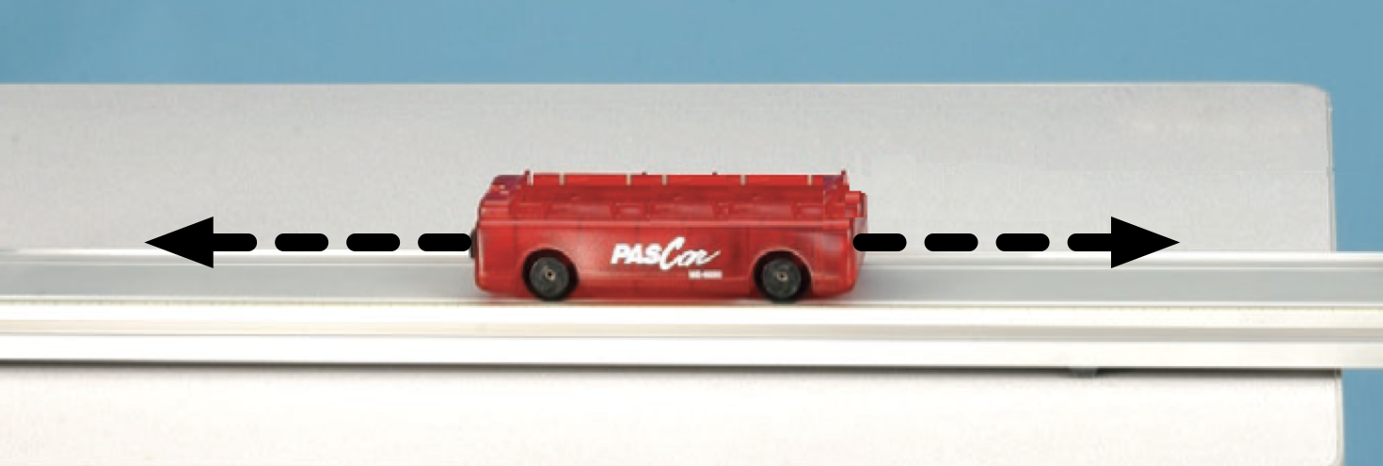
Newton’s First Law
Setup
Set cart onto the track, and then adjust the level of the track using its adjustable feet such that the cart remains stationary when left at rest.
Cut a piece of string (approximately 1 m long) in preparation for data collection.

Slide 13
Newton’s First Law
Collect Data
With the cart stationary in the middle of the track, tap to begin data collection.
After ~5 s tap to stop data collection.
Now place the dynamics cart on the track approximately 15 cm in front of the motion sensor.
Proceed to the next page…

Slide 14
Newton’s First Law
Collect Data
4. Tap to start collection then give the cart a soft push towards the super pulley, rolling it down the track.
Note: Be certain that your hand/arm does not obstruct the motion sensor's line of sight.
Catch the cart just before it hits the super pulley at the end of the track.
6. Tap to stop data collection.

Slide 15
Newton’s First Law
Collect Data
For the final run of data you will tie one end of your 1 m piece of string to the front of the dynamics cart, and the other end to the mass hanger.
Run the string over the pulley with the mass hanger hanging freely below the pulley.
Hold the cart in place ~15 cm in front of the motion sensor then attach 20 g of mass to the hanger. Continue to hold the cart.
Proceed to the next page…

Slide 16
Newton’s First Law
Collect Data
Tap to start data collection then release the cart allowing it to freely roll down the track.
Note: Be certain that your hand does not obstruct the motion sensor's line of sight.
Catch the cart just before it hits the super pulley at the end of the track.
Tap to stop data collection.

Slide 17
Newton’s First Law
Analysis
How is the velocity of the cart in Run #1 changing? Is there a net force acting on the cart? If yes, what is that force caused by?
Notes:
L6-Text Box
[The velocity of the cart in Run#1 is…]

Slide 18
Newton’s First Law
Analysis
2. Explain how you could tell how the cart's position was changing from a Velocity versus Time graph rather than directly from a Position versus Time graph.
Notes:
L4,5,6-Text Box
[[I/We] could determine how the position of the cart was changing from the velocity versus time graph because…]

Slide 19
Newton’s First Law
Analysis
How is the velocity of the cart in Run #2 changing? Was there a net force acting on the cart? If yes, what was that force caused by?
Notes:
L6-Text Box
[The velocity of the cart in Run#2 is…]

Slide 20
Newton’s First Law
Analysis
How is the velocity of the cart in Run #3 changing? Was there a net force acting on the cart? If yes, what was that force caused by?
Notes:
L6-Text Box
[The velocity of the cart in Run#3 is…]

Slide 21
Newton’s First Law
Analysis
5. What evidence from the Velocity versus Time graph for Run #3 indicated there was a net force acting on the cart?
Notes:
L6-Text Box
[…indicated that there was a net force acting on the cart.]

Slide 22
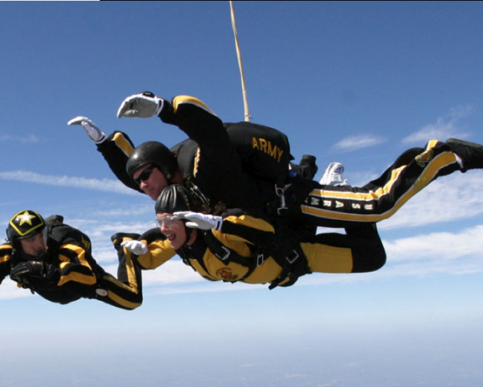
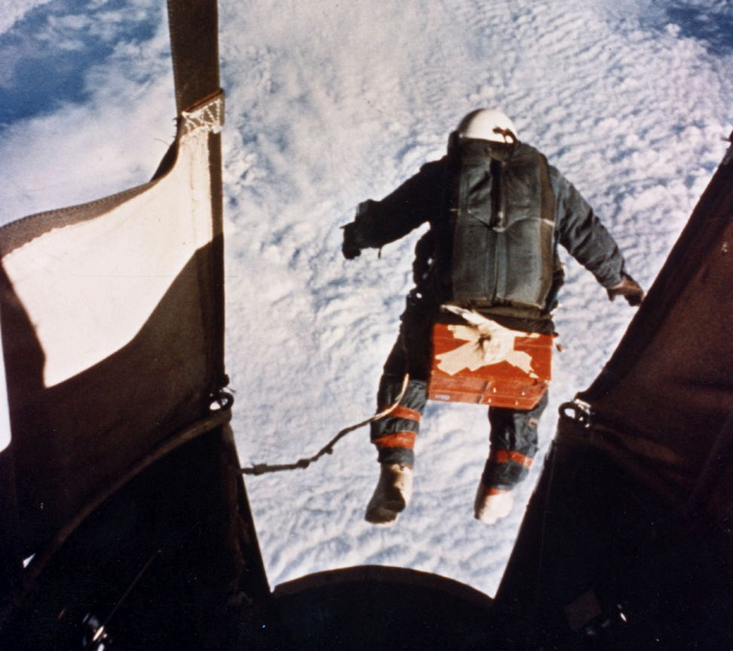
Newton’s First Law
Synthesis
1. What happens to the velocity of an object if it never experiences an unbalanced force?
Notes:
L6-Text Box
[The velocity will…]

Slide 23
Newton’s First Law
Synthesis
2. How do forces affect the motion of objects? (Think of a force as a push or a pull acting on an object.)
Notes:
L4,5,6-Text Box
[Forces affect motion by…]

Slide 24
Newton’s First Law
Synthesis
3. Is it possible for an object to experience a net force without physically touching another object? If yes, give an example.
Notes:
L4,5,6-Text Box
[Yes/no…]

Slide 25
Newton’s First Law
Synthesis
4. An object's resistance to changes in motion is called inertia. What property of matter gives an object inertia? Give an example of something with a relatively large amount of inertia, and something else with a relatively small amount.
Notes:
L4,5,6-Text Box
[Inertia is related to an object’s…]
[An example of an object with larger inertia is…]
[An example of an object with smaller inertia is…]

Slide 26
Newton’s First Law
Synthesis
5. What would happen to a ball if you threw it in deep space where there were no forces acting on it? Describe its motion during the time you are in contact with it, and then after you release it.
Notes:
L4,5,6-Text Box
[If you threw a ball in deep space it would…]

Slide 27
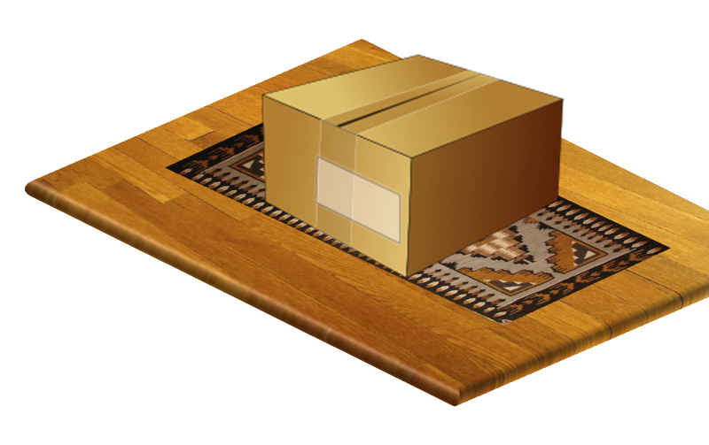
Newton’s First Law
Multiple Choice Question
You slide a box across the floor at a constant velocity. Which of the following statements is true?
Your pushing force equals the resisting force of friction.
Your pushing force must be greater than the force of friction.
Your pushing force is less than the force of friction.
Once you let go of the box it will immediately come to a stop.
Notes:
L6-Text Box
[The best choice is…]

Slide 28
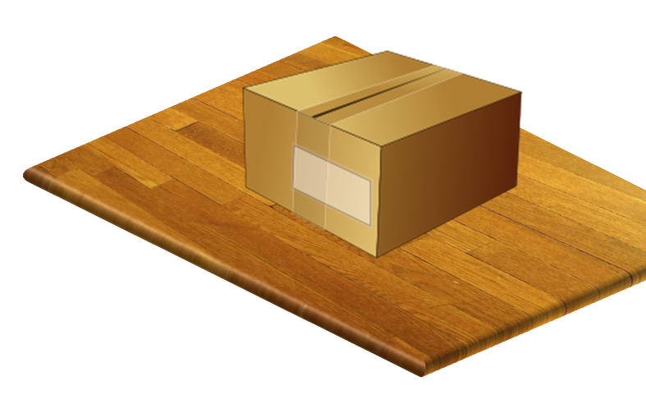
Newton’s First Law
Multiple Choice Question
If you continue to push with the same force after the box slides onto a surface with less friction, which of the following statements is true?
The box will speed up until it reaches a faster velocity and then continue at that velocity.
The box will speed up continuously as long as you continue to push with the same force.
The box will continue to slide at its original speed.
If you let go of the box it will continue to move indefinitely.
Notes:
L6-Text Box
[The best choice is…]

Slide 29
Newton’s First Law
Multiple Choice Question
If an object experiences a constant net _______ it will have a constant ________. However, if nothing else interacts with an object it will maintain a constant ________ indefinitely.
acceleration, force, velocity
velocity, acceleration, force
force, acceleration, velocity
force, velocity, acceleration
Notes:
L6-Text Box
[The best choice is…]

Slide 30
Newton’s First Law
Congratulations!
You have completed the lab.
Please remember to follow your teacher's instructions for cleaning-up and submitting your lab.
Notes:
Color scheme (RGB values)
biology 121, 173, 54
chemistry 0 176, 216
physics 0, 102, 204
earth 204, 102, 0
middle 153, 102, 153
elementary 255, 51, 0

Slide 31
Newton’s First Law
References
ALL IMAGES WERE TAKEN FROM PASCO DOCUMENTATION, PUBLIC DOMAIN CLIP ART, OR WIKIMEDIA FOUNDATION COMMONS:
http://commons.wikimedia.org/wiki/File:STS-121_launch.jpg
http://commons.wikimedia.org/wiki/File:GodfreyKneller-IsaacNewton-1689.jpg
http://commons.wikimedia.org/wiki/File:Astronaut-EVA.jpg
http://commons.wikimedia.org/wiki/File:Relativistic_electromagnetism_fig4.svg
http://commons.wikimedia.org/wiki/File:Kittinger-jump.jpg
http://commons.wikimedia.org/wiki/File:CCooley1.jpg
http://commons.wikimedia.org/wiki/File:Simple_cardboard_box.svg
http://www.freeclipartnow.com/office/paper-shredder.jpg.html
http://www.pdclipart.org/albums/Transportation_and_Travel/normal_Balloon.png

