Slide 1
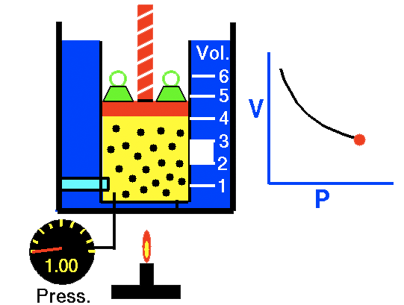
Volume vs. Pressure!
Boyle’s Law
012-10734 r1.04

Slide 2
Boyle’s Law
Introduction
Each page of this lab that contains the symbol
should be inserted into your journal. After completing a lab page with the snapshot symbol, tap (in the upper right hand corner) to insert the page into your journal.
Journals and Snapshots
The Snapshot button is used to capture the screen.
The Journal is where snapshots are stored and viewed.
The Share button is used to export or print your journal to turn in your work.
Note: You may want to take a
snapshot of the first page of
this lab as a cover page for
your Journal.

Slide 3
Boyle’s Law
Lab Challenge
Determine the effect of volume on the pressure of a closed system containing a fixed amount of molecules at a constant temperature.
What would happen to the pressure inside the exercise ball if you decreased its volume by sitting on it?
A sealed exercise ball contains a fixed amount of gas molecules at a fixed temperature.

Slide 4
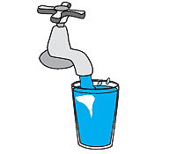
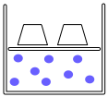
Boyle’s Law
Background
Solids and liquids take up a fixed amount of space. The volume of gases, however, can change.
Gas molecules can be compressed into smaller volumes and when released into larger volumes the gas molecules will spread out and fill all the available space.

Slide 5
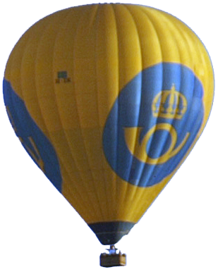
Boyle’s Law
Self-Check
_____________ molecules can be compressed into smaller volumes.
Solid
Liquid
Gas
Solid, liquid, and gas
Notes:
L6 – text box
[ The best choice is… (tap here to enter text) ]

Slide 6
Boyle’s Law
...Background
The ability of gases to change the amount of space they occupy is explained by the kinetic molecular theory of gases.
The kinetic molecular theory of gases explains that:
gas particles are small hard spheres that are so far apart that their volume can be considered zero.
gas particles move in straight lines until they collide with another particle or surface forcing them to change direction.
the movement of gases is random and their collisions are considered elastic because they do not gain or lose energy when they collide.
KE_{i} = KE_{f}

Slide 7
Boyle’s Law
Self-Check
According to the kinetic molecular theory, gas molecules are positioned so far apart that their volume is considered to occupy __________ of their container.
70%
50%
30%
0%
Gas molecules
Notes:
L6 – text box
[ The best choice is… ]

Slide 8
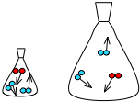
Boyle’s Law
...Background
A gas that behaves according to these assumptions is considered an ideal gas. Although there is no such thing as an ideal gas, at many conditions of temperature and pressure, real gases behave ideally.
Ideal gases follow many laws including Boyle's law. Boyle's law describes the relationship between the pressure P of a gas and the volume V it occupies (at constant temperature).
Force
2 N
Area
Pressure is the average force spread over an area. Gas molecules exert pressure when they collide with their container.
100 mL
500 mL
Volume is the space matter occupies.

Slide 9
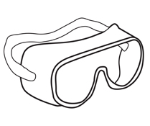
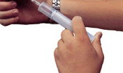
Boyle’s Law
Safety:
Follow all common laboratory safety procedures.
Avoid over-compressing the air in the syringe to minimize the risk of injury or damage to the equipment.

Slide 10
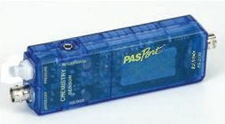
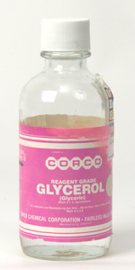
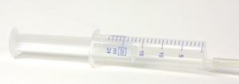
Boyle’s Law
Materials and Equipment:
Collect all of these materials before beginning the lab.
Absolute pressure sensor
Sensor extension cable
Syringe, 20-mL or 60-mL
Tubing, 1- to 2-cm
Quick-release connector
Glycerin, 2 drops
Glycerin

Slide 11
Boyle’s Law
Sequencing Challenge
The steps to the left are part of the procedure for this lab activity. They are not in the right order. Determine the correct sequence of the steps, then take a snapshot of this page.
A. Connect a syringe with 20 mL of air in it to the absolute pressure sensor.
B. Calculate the average pressure at each volume and use them to determine the relationship between P and V.
C. Record the absolute pressure P at 20 mL, 18 mL, 16 mL, 14 mL, 12 mL, 10 mL, 8 mL, and 6 mL.
D. Collect two additional sets of absolute pressure data at each volume V.
Notes:
L6 – text box
[ The correct sequence of steps is… ]

Slide 12
Boyle’s Law
Prediction
Q1: What will happen to the pressure in the syringe as the volume decreases? Draw your prediction on the graph provided.*
*To Draw a Prediction:
1. Tap to open the tool palette.
2. Tap then use your finger to draw your prediction.
3. Tap when finished.
4. If you make a mistake, tap
to clear your prediction.

Slide 13
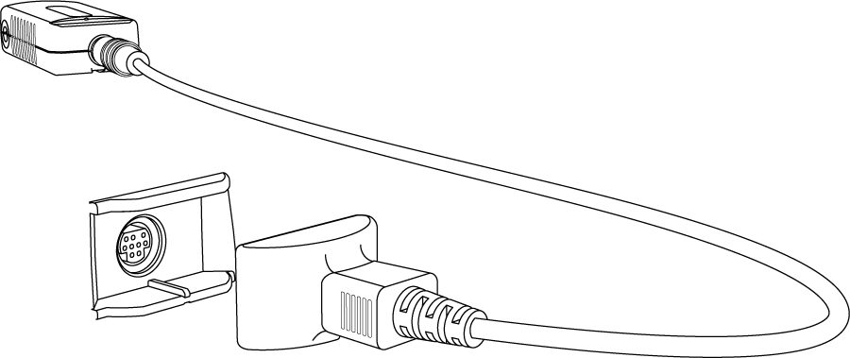
Boyle’s Law
Setup
Connect the absolute pressure sensor to the data collection system using the sensor extension cable.
Absolute pressure sensor
Extension cable

Slide 14
Boyle’s Law
Setup
Q2: What is the independent variable in this experiment? What units will it be measured in?
Connect the syringe to the quick-release connector using a piece of tubing. Put a drop of glycerin on the connecting pieces as necessary.
Syringe
Tubing, 1-2 cm
Quick-release connector
Glycerin drop
Glycerin drop
Notes:
L6 – text box
[ The independent variable is… ]
[ Units… ]

Slide 15
Boyle’s Law
Setup
Q3: What is the dependent variable in this experiment? What units will it be measured in?
Withdraw the plunger until there is 20 mL of air in the syringe.
Insert the quick-release connector into the port of the absolute pressure sensor and then turn the connector clockwise until the fitting “clicks” (about one-eighth of a turn).
Pressure port
Quick-release connector
Notes:
L6 – text box
[ The independent variable is… ]
[ Units… ]

Slide 16
Boyle’s Law
Procedure
Tap to start a data set.
Set the syringe volume to 20 mL.
When the pressure has stabilized, tap to record the pressure.
Repeat steps 2-3, but set the syringe volume to 18 mL, 16 mL, 14 mL, 12 mL, 10 mL, 8 mL and 6 mL.
Tap to stop the data set.
Notes:
Table – Volume and Absolute pressure

Slide 17
Boyle’s Law
Remove the syringe from the sensor using the quick-release connector.
Set the syringe plunger to 20 mL and re-connect the syringe to the sensor.
Tap to start the second data set.
Set the syringe volume to each volume listed and tap when the pressure stabilizes.
Tap to stop the data set.

Slide 18
Boyle’s Law
Q4: Explain when and why it becomes difficult to depress the syringe.
Q5: What is inside the syringe that is causing the pressure?
Q6: Why is it important to collect multiple runs of data in an experiment?
Notes:
L4 – text box
[ It becomes difficult to depress the syringe… ]
L5 – text box
[ The pressure inside the syringe is cause by… ]
L6 – text box
[ It is important to collect multiple runs of data… ]

Slide 19
Boyle’s Law
Remove the syringe from the sensor using the quick-release connector.
Set the syringe plunger to 20 mL and re-connect the syringe to the sensor.
Tap to start the third data set.
Set the syringe volume to each volume listed and tap when the pressure stabilizes.
Tap to stop the data set.

Slide 20
Boyle’s Law
Data Analysis
Calculate the average pressure for each volume. Enter the average into the data table.*
*To Enter Data into a Table:
Tap to open the tool palette.
Tap then tap a cell in the data table to highlight it in yellow.
Tap to open the Keyboard screen.

Slide 21
Boyle’s Law
Data Analysis
Describe the overall trend seen in this graph. How can the relationship between pressure and volume be represented mathematically?
Notes:
L6 – text box
[ As the volume in the syringe decreases, the pressure… ]
[ Mathematically… ]

Slide 22
Boyle’s Law
Data Analysis
Calculate the constant "k" for each run of data. Enter the constant into the data table.* P×V= k (Boyle's Law)
*To Enter Data into a Table:
Tap to open the tool palette.
Tap then tap a cell in the data table to highlight it in yellow.
Tap to open the Keyboard screen.

Slide 23
Boyle’s Law
Data Analysis
What is the constant "k" for air? Find the average of the average "k" values calculated at each volume.
Notes:
L6 – text box
[ The constant “k” for air is… ]

Slide 24
Boyle’s Law
Data Analysis
Create a best fit line (linear fit) of the constant "k" versus volume data.*
*To Apply a Curve Fit:
1. Tap to open the tool palette.
2. Tap to open the Curve Fit screen.
3. Tap the name of the curve fit required.

Slide 25
Boyle’s Law
Data Analysis
The graph on the previous page shows "k" versus volume. Note that for an "ideal gas" the value of "k" should be constant across all volumes. Does the gas tested in this lab act like an "ideal gas" at all volumes? Explain why or why not.
Notes:
L456 – text box
[ The gas tested in this lab… ]

Slide 26
Boyle’s Law
Analysis
Are pressure and volume directly proportional or inversely proportional? How do you know? Provide evidence from this lab.
Notes:
L456 – text box
[ Pressure and volume are… ]

Slide 27
Boyle’s Law
Analysis
2a. What region of the pressure versus volume graph does air behave like an ideal gas? Like a real gas?
2b. What is the difference between an ideal gas and a real gas?
Notes:
L456 – text box
[ a. Air behaves like an ideal gas at… ]
[ b. Ideal gases and real gases differ… ]

Slide 28
Boyle’s Law
Analysis
Calculate the pressure you would expect at a cylinder volume of 15.0 mL. Show your work.
Note: Tap to look in your journal for values determined earlier in the lab.
Notes:
L456 – text box
[ Work: ]
[ Pressure at 15 mL = ]

Slide 29
Boyle’s Law
Synthesis
Explain why it is possible to write Boyle’s law as both PV = k and P₁V₁ = P₂V₂.
Notes:
L456 – text box
[ Boyle’s Law can be written both ways… ]

Slide 30
Boyle’s Law
Synthesis
A helium balloon is released into the atmosphere. As it rises, atmospheric pressure decreases.
What do you expect will happen to the volume of the balloon? Why?
Notes:
L456 – text box
[ The volume of the balloon will… ]

Slide 31
Boyle’s Law
Synthesis
How could you change the experimental design to get results more consistent with an ideal gas?
Notes:
L456 – text box
[ To get better results… ]

Slide 32
Boyle’s Law
Synthesis
A cylinder containing 250 mL of a gas has a pressure of 350 kPa. If the gas was compressed to a volume of 45 mL what would the pressure change to? Show your work.
Hint: Use P₁V₁ = P₂V₂
Notes:
L456 – text box
[ Work: ]
[ Pressure would become: ]

Slide 33
Boyle’s Law
Multiple Choice
At room temperature, air behaves like an ideal gas at _______________.
low pressures
high pressures
all pressures
air never behaves ideally
Notes:
L6 – text box
[ The best choice is… ]

Slide 34
Boyle’s Law
Multiple Choice
What condition will cause the volume of a gas to decrease?
an increase in the amount of gas
an increase in the temperature
an increase in pressure
a decrease in pressure
Notes:
L6 – text box
[ The best choice is… ]

Slide 35
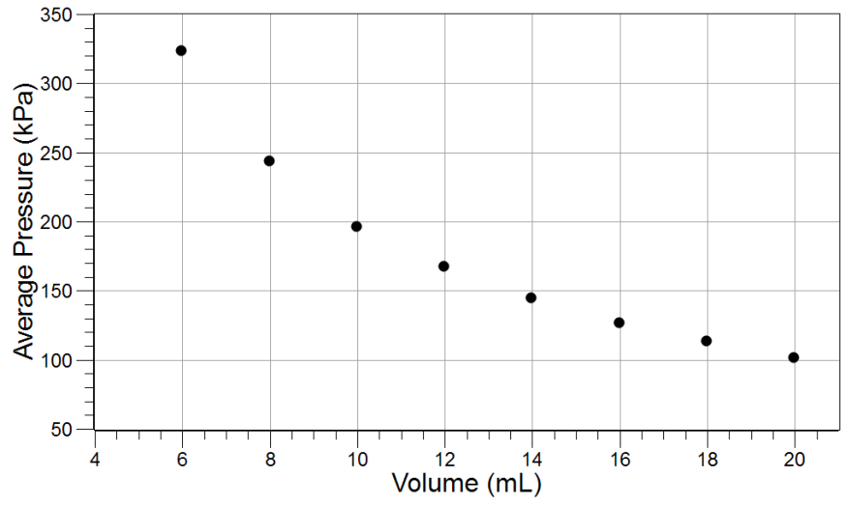
Boyle’s Law
Multiple Choice
At a constant temperature the relationship between the volume V of a gas and its pressure P is ___________.
V = (constant)P
P = (constant)V
PV = constant
V/P = constant
Notes:
L6 – text box
[ The best choice is… ]

Slide 36
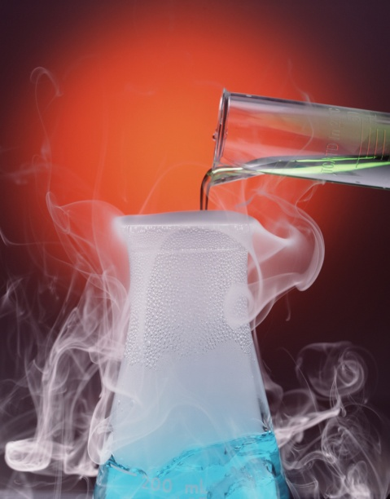
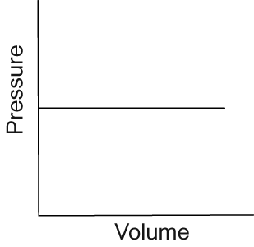
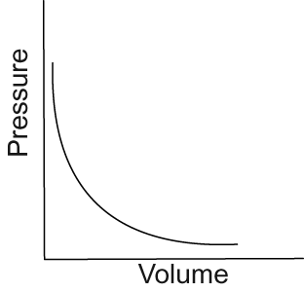
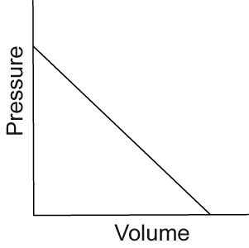
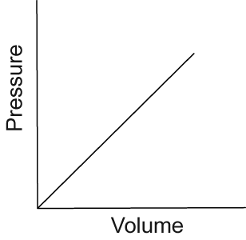
Boyle’s Law
Multiple Choice
4. Which graph shows the relationship between the pressure and volume of nitrogen gas at a constant temperature?
Evaporation of
liquid nitrogen
A)
B)
C)
D)
Notes:
L6 – text box
[ The best choice is… ]

Slide 37
Boyle’s Law
Multiple Choice
A gas contained in a 3.0 L cylinder has a pressure of 120 kPa. What will the new volume be if the pressure is increased to 240 kPa?
1.5 L
3.0 L
4.5 L
6.0 L
Notes:
L6 – text box
[ The best choice is… ]

Slide 38
Boyle’s Law
Congratulations!
You have completed the lab.
Please remember to follow your teacher's instructions for cleaning-up and submitting your lab.
Notes:
Color scheme (RGB values)
biology 121, 173, 54
chemistry 0 176, 216
physics 0, 102, 204
earth 204, 102, 0
middle 153, 102, 153
elementary 255, 51, 0

Slide 39
Boyle’s Law
References
All images were taken from PASCO documentation, public domain clip art, or Wikimedia Foundation Commons.
BOYLE'S LAW DIAGRAM: http://commons.wikimedia.org/wiki/Image:Boyles_Law_animated.gif
YOGA LADY http://www.freeclipartnow.com/recreation/sports/fitness/yoga.jpg.html
PURPLE BALLOON http://www.freeclipartnow.com/recreation/partying/balloon-purple-aj.jpg.html
HOT AIR BALLOON: http://www.openstockphotography.org/image-licensing/balloon/Hotairballoon- stockholm.jpg

