Slide 1
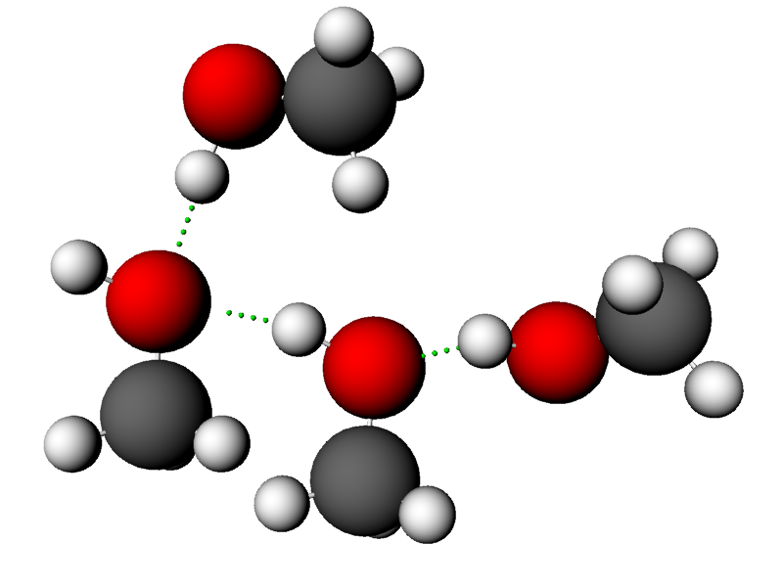
Intermolecular Forces
012-10746 r1.04

Slide 2
Intermolecular Forces
Introduction
Each page of this lab that contains the symbol
should be inserted into your journal. After completing a lab page with the snapshot symbol, tap (in the upper right hand corner) to insert the page into your journal.
Journals and Snapshots
The Snapshot button is used to capture the screen.
The Journal is where snapshots are stored and viewed.
The Share button is used to export or print your journal to turn in your work.
Note: You may want to take a
snapshot of the first page of
this lab as a cover page for
your Journal.

Slide 3
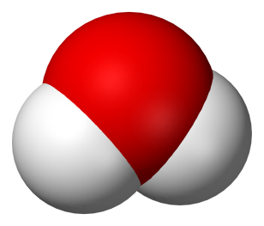
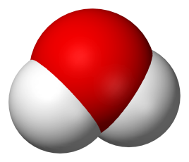
Intermolecular Forces
Lab Challenges
If chemical bonds hold atoms together to form molecules, what holds the molecules together to form solids and liquids?
Determine which type of alcohol holds its molecules together the strongest.
Explain how the length of a molecule and the shape of a molecule affect the strength with which molecules are held together.
Intermolecular
forces hold molecules together
Chemical bond
Water molecules

Slide 4
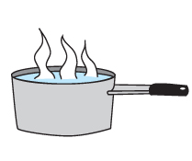
Intermolecular Forces
Background
Evaporation is the process of changing from a liquid to a gas.
The rate at which a substance evaporates depends on several variables including temperature of the liquid, amount of surface area of the liquid that is exposed, and the molecular structure of the liquid.
Gas
Liquid

Slide 5
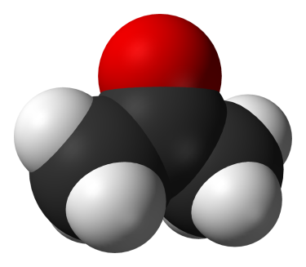
Intermolecular Forces
...Background
The structure of the molecules that make up a liquid cause liquids to evaporate at different rates because the molecules are held together by varying strengths of attraction. The attractions between molecules are called intermolecular forces.
Molecules with strong intermolecular forces evaporate at slower rates because more energy is required to "break" the attraction holding the molecules together. Molecules with weaker intermolecular forces evaporate more quickly.
Strong hydrogen bonds hold water molecules together.
Weak dipole-dipole forces hold acetone molecules together.

Slide 6
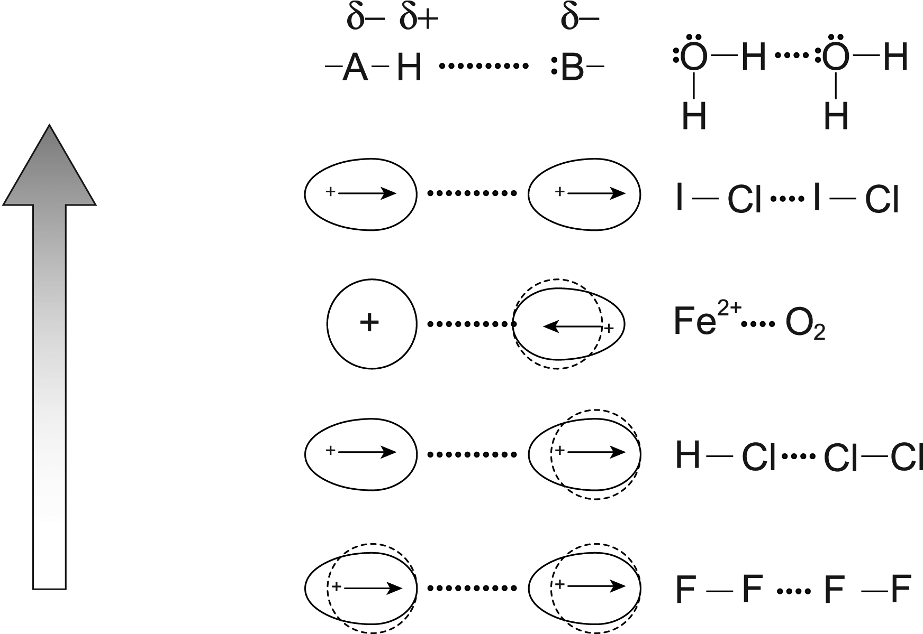
Intermolecular Forces
...Background
The different types of intermolecular attractions are:
Strongest
Hydrogen bonding
Dipole-dipole
Ion-induced dipole
Dipole-induced dipole
Dispersion (London)
Weakest

Slide 7
Intermolecular Forces
Self-Check
Evaporation is the process of changing from a ________________________.
gas to a liquid
liquid to a solid
solid to a gas
liquid to a gas
solid to a liquid
Notes:
L6 – text box
[ The best choice is … (tap here to enter text) ]

Slide 8
Intermolecular Forces
Self-Check
What are intermolecular forces?
gravity
attraction between molecules
the process of changing from one phase to another
surface area and temperature
the bonds within a molecule
Notes:
L6 – text box
[ The best choice is … ]

Slide 9
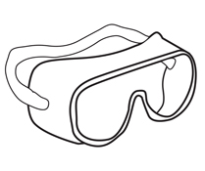
Intermolecular Forces
Safety
Follow all common laboratory safety procedures.
Use a wafting motion when smelling chemicals.
Alcohols are flammable. Smother fires with sand or a Type B fire extinguisher.
Wash hands with soap and water after handling chemicals, glassware, or equipment.
BE SAFE
Always wash hands to remove residue before leaving

Slide 10
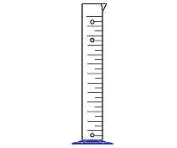
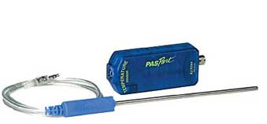
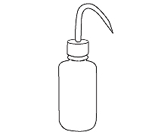
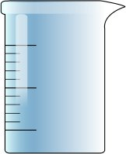
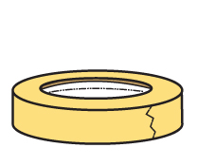
Intermolecular Forces
Materials and Equipment
Collect all of these materials before beginning the lab.
Stainless steel temperature sensor
Graduated cylinder, 10-mL
Test tubes (6), 15-mm x 100-mm
Stoppers (6), to fit test tubes
Test tube rack
Wash bottle and waste container
Masking tape, 6-cm strips (2)
waste

Slide 11
Intermolecular Forces
...Materials and Equipment
Also collect these additional materials before starting.
Methanol, 5 mL
Ethanol, 5 mL
Propanol, 5 mL
Butanol, 5 mL
2-propanol, 5 mL
2-butanol, 5 mL
Methanol
Ethanol
2-propanol
Propanol
Butanol
2-butanol

Slide 12
Intermolecular Forces
Sequencing Challenge
The steps to the left are part of the procedure for this lab activity. They are not in the right order. Determine the correct sequence of the
steps, then take a snapshot
of this page.
A. Place the temperature sensor in a test tube containing 5 mL of methanol and start collecting data.
B. Observe the change in temperature and stop collecting data when the temperature begins to stabilize.
C. Repeat the process for each of the other alcohols.
D. Immediately remove the sensor from the methanol and allow the methanol to evaporate from the sensor.
Notes:
L – text box
[ The correct sequence of steps is … ]

Slide 13
Intermolecular Forces
Setup
Q1: Why is it necessary to stopper the test tube containing alcohol?
Use a graduated cylinder to measure approximately 5 mL of methanol. Transfer the methanol into a labeled test tube and seal it with a stopper.
Clean the graduated cylinder by rinsing it several times with water and then drying it.
Repeat steps 1-2 using ethanol, propanol, butanol, 2-propanol, and 2-butanol.
Connect a stainless steel temperature sensor to the data collection system.
Notes:
L6 – text box
[ The stopper … ]

Slide 14
Intermolecular Forces
Q2: What will happen to the temperature as each alcohol evaporates from the temperature sensor? Draw your prediction on the graph provided.*
Hint: Energy is used up to break the attraction
between molecules.
*To Draw a Prediction:
Tap to open the tool palette.
Tap then use your finger to draw your prediction.
Tap when finished.
If you make a mistake, tap to clear your prediction.

Slide 15
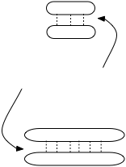
Intermolecular Forces
Predictions
Q3: How will the temperature changes during evaporation compare among the four different alcohols of the homologous series.
Methanol
Ethanol
Intermolecular forces
Propanol
Butanol
Notes:
L6 – text box
[ The temperature changes during evaporation for the four straight chain alcohols will … ]

Slide 16
Intermolecular Forces
Predictions
Q4: How will the temperature changes during evaporation compare between the isomeric forms of the alcohols.
Isomeric pair 1:
Straight chain
Propanol (straight chain)
2-propanol (spherical)
Isomeric pair 2:
Spherical
Butanol (straight chain)
2-butanol (spherical)
Notes:
L6 – text box
[ The temperature changes during evaporation between the isomeric alcohols will … ]

Slide 17
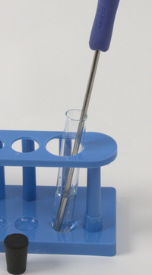
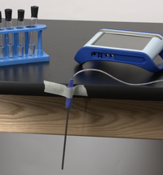
Intermolecular Forces
Collect Data
Remove the stopper from the test tube containing methanol, and place the temperature sensor in the liquid.
Tap to start collecting data.
Remove the temperature sensor from the methanol and tape it so that the metal section is hanging over the edge of the lab table.
Continue to the next page to see the data being collected.

Slide 18
Intermolecular Forces
If the temperature change cannot be seen, re-scale the axes.*
Replace the stopper on the test tube of methanol.
When the temperature has stabilized, tap to stop collecting data.
*To Scale a Graph:
Tap to open the tool palette.
Tap to scale the graph.
If you need to manually scale the graph, touch one of the numbers labeling an axis and drag it up or down.

Slide 19
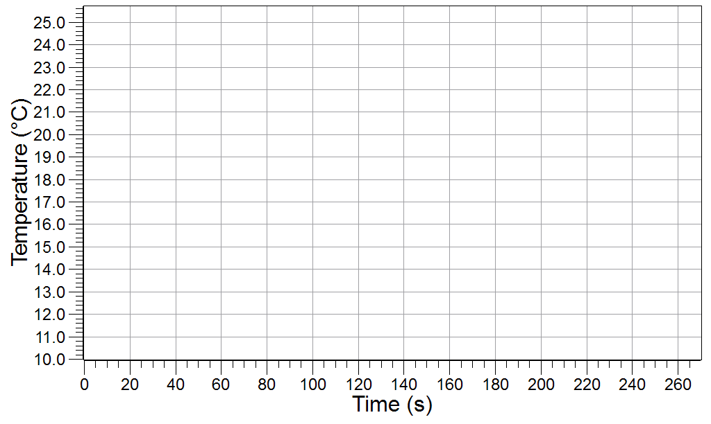
Intermolecular Forces
Q5: What happened to the methanol that was on the temperature sensor?
Q6: State how the temperature changed and explain why.
?
Notes:
L4 – text box
[ The methanol on the temperature sensor … ]
L6 – text box
[ The temperature because … ]

Slide 20
Intermolecular Forces
Q7: How can the evaporation rate be determined from the graph?
Notes:
L6 – text box
[ The evaporation rate can be determined from … ]

Slide 21
Intermolecular Forces
Collect Data
Rinse the temperature sensor several times with clean water and then dry it completely.
Remove the stopper from the test tube containing ethanol, and place the temperature sensor in the liquid. Tap to start collecting data.
Remove the temperature sensor from the ethanol and tape it so that the metal section is hanging over the edge of the lab.
Continue to the next page to see the data being collected.

Slide 22
Intermolecular Forces
Replace the stopper on the test tube of ethanol.
When the temperature stabilizes, tap to stop collecting data.
Clean and dry the temperature sensor.
Repeat the procedure with the remaining alcohols:
run 3: propanol
run 4: butanol
run 5: 2-propanol
run 6: 2-butanol

Slide 23
Intermolecular Forces
Data Analysis
Practice showing and hiding runs of data.*
Practice changing the run that is selected (tap the symbol in the legend). The analysis tools only apply to the selected run.
Selected
* To Show Specific Runs of Data:
Tap the legend.
Tap so that a check mark is present next to each run that you want to display.
Touch outside the legend to reduce the size of the legend.

Slide 24
Intermolecular Forces
3. Practice finding the overall change in temperature for a run of data.
Note: On the next page you will be asked to find the change in temperature for specific runs and enter these values in a text box.
* To Find the Minimum and Maximum of a Run of Data:
Tap to open the tools palette.
Tap to open the Graph Statistics.
Choose Minimum and Maximum and tap OK.

Slide 25
Intermolecular Forces
4. Determine the change in temperature for each straight chain alcohol:
run 1: methanol
run 2: ethanol
run 3: propanol
run 4: butanol
Notes:
L6 – text box
[ Enter the change in temperature here. ]
[ methanol: ]
[ ethanol: ]
[ propanol: ]
[ butanol: ]

Slide 26
Intermolecular Forces
Determine the change in temperature for each of the isomeric alcohol pairs:
run 3: propanol
run 5: 2-propanol
run 4: butanol
run 6: 2-butonol
Notes:
L6 – text box
[ Enter the change in temperature here. ]
[ propanol: ]
[ 2-propanol: ]
[ butanol: ]
[ 2- butanol: ]

Slide 27
Intermolecular Forces
6. Practice determining the rate of evaporation rate (slope) for the first 20 seconds in which the temperature decreases.*
Note: On the next page you will be asked to find the evaporation rate for specific runs and enter these values in a text box.
* To Find the Slope for a Portion of a Run of Data:
Tap to open the tools palette.
Tap and then tap two points on the data run.
Adjust using both buttons and then tap .
Tap and select linear fit then tap OK (m=slope).

Slide 28
Intermolecular Forces
7. Determine the evaporation rate (slope) for the first 20 seconds in which the temperature decreases for each straight chain alcohol.
Notes:
L6 – text box
[ Enter the evaporation rates here. ]
[ methanol: ]
[ ethanol: ]
[ propanol: ]
[ butanol: ]

Slide 29
Intermolecular Forces
8. Display the two pairs of isomeric alcohols and then determine the evaporation rate (slope) for the first 20 seconds in which the temperature decreases.
Notes:
L6 – text box
[ Enter the evaporation rates here. ]
[ propanol: ]
[ 2-propanol: ]
[ butanol: ]
[ 2-butanol: ]

Slide 30
Intermolecular Forces
Analysis
How does evaporation affect temperature? Explain.
Notes:
L456 – text box
[ The magnitude of the evaporation rate … ]

Slide 31
Intermolecular Forces
Analysis
Methanol
Explain how the magnitude of the evaporation rate changed with the size of the molecules in the homologous series of alcohols.
Ethanol
Propanol
Butanol
Notes:
L456 – text box
[ The magnitude of the evaporation rate … ]

Slide 32
Intermolecular Forces
Analysis
Isomeric pair 1:
Explain how the magnitude of the evaporation rate changed with the shape of the molecules in the isomeric alcohol pairs.
Propanol
2-propanol
Isomeric pair 2:
Butanol
2-butanol
Notes:
L456 – text box
[ The magnitude of the evaporation rate … ]

Slide 33
Intermolecular Forces
Analysis
Which alcohol from the experiment has the strongest intermolecular forces? How does your data support your answer?
Intermolecular force
Notes:
L456 – text box
[ The alcohol with the strongest intermolecular forces is … ]
[ My data supports this answer because … ]

Slide 34
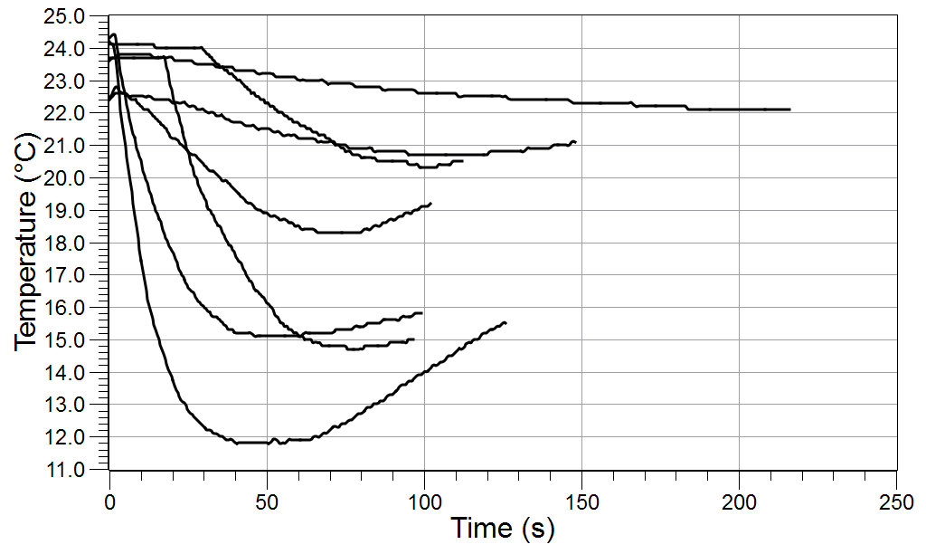
Intermolecular Forces
Analysis
Which alcohol from the experiment has the weakest intermolecular forces? How does your data support your answer?
Notes:
L456 – text box
[ The alcohol with the weakest intermolecular forces is … ]
[ My data supports this answer because … ]

Slide 35
Intermolecular Forces
Analysis
Methanol
Explain the effects of molecular size on the strength of intermolecular forces for different alcohols from the same homologous series.
Ethanol
Propanol
Butanol
Notes:
L456 – text box
[ Larger molecules have … ]

Slide 36
Intermolecular Forces
Analysis
Isomeric pair 1:
Explain the effects of molecular shape on the strength of intermolecular forces for different isomeric alcohol pairs.
Propanol
2-propanol
Isomeric pair 2:
Butanol
2-butanol
Notes:
L456 – text box
[ Spherical molecules have … ]

Slide 37
Intermolecular Forces
Synthesis
Vigorous exercise causes people to sweat. How does perspiration regulate body temperature?
Notes:
L456 – text box
[ Perspiration regulates the body temperature … ]

Slide 38
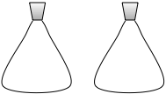
Intermolecular Forces
Synthesis
If you enclosed methanol in one container and butanol in a second container, how would the pressure in those containers compare? Why?
Methanol
Butanol
Notes:
L456 – text box
[ The pressure in the container containing methanol … ]
[ This is because … ]

Slide 39
Intermolecular Forces
Synthesis
???
Which do you expect to have the higher boiling point, butanol or 2-butanol? Why?
Butanol
2-butanol
Notes:
L456 – text box
[ … will have the higher boiling point because … ]

Slide 40
Intermolecular Forces
Synthesis
Would you expect water (H₂O) to or hydrogen sulfide (H₂S) to have stronger intermolecular attractions? Explain your reasoning.
Notes:
L456 – text box
[ …would be expected to have the stronger intermolecular attractions. ]
[ This is because … ]

Slide 41
Intermolecular Forces
Multiple Choice
Methanol
Which alcohol will evaporate the fastest?
methanol
ethanol
propanol
butanol
Ethanol
Propanol
Butanol
Notes:
L6 – Text box
[ The best choice is … ]

Slide 42
Intermolecular Forces
Multiple Choice
Strongest
Which of the following are the strongest intermolecular forces found in propanol?
dipole-dipole
dispersion (London)
ionic bonding
hydrogen bonding
Notes:
L6 – Text box
[ The best choice is … ]

Slide 43
Intermolecular Forces
Multiple Choice
Methanol
How does the size of an alcohol affect the strength of its intermolecular forces?
As the size of the alcohol decreases, the strength of intermolecular forces increase.
As the size of the alcohol decreases, the strength of intermolecular forces decrease.
As the size of the alcohol increases, the strength of its intermolecular forces decreases.
The size of the alcohol does not have an effect on its intermolecular forces.
Ethanol
Propanol
Butanol
Notes:
L6 – Text box
[ The best choice is … ]

Slide 44
Intermolecular Forces
Multiple Choice
As a liquid evaporates, the temperature of the remaining liquid will ____________.
decrease
increase
stay the same
increase or decrease depending on the liquid
Notes:
L6 – Text box
[ The best choice is … ]

Slide 45
Intermolecular Forces
Multiple Choice
Hydrogen bonding
Strongest
Which of the following substances has the weakest intermolecular forces of attraction?
H₂O
Cl₂
C₄H₁₁OH
NH₃
Dipole-dipole
Ion-induced dipole
Dipole-induced dipole
Dispersion (London)
Notes:
L6 – Text box
[ The best choice is … ]

Slide 46
Intermolecular Forces
Congratulations!
You have completed the lab.
Please remember to follow your teacher's instructions for cleaning-up and submitting your lab.
Notes:
Color scheme (RGB values)
biology 121, 173, 54
chemistry 0 176, 216
physics 0, 102, 204
earth 204, 102, 0
middle 153, 102, 153
elementary 255, 51, 0

Slide 47
Intermolecular Forces
References
All images were taken from PASCO documentation, public domain clip art, or Wikimedia Foundation Commons.
WATER MOLECULE http://commons.wikimedia.org/wiki/File:Water-3D-vdW.png
ACETONE MOLECULE http://commons.wikimedia.org/wiki/File:Acetone-3D-vdW.png
BE SAFE http://freeclipartnow.com/signs-symbols/warnings/safety-hands.jpg.html
FLAMMABLE http://freeclipartnow.com/signs-symbols/yellow/MatieresInflammables.jpg.html
BEAKER http://www.freeclipartnow.com/science/flasks-tubes/beaker-2.jpg.html
THERMOMETER http://www.freeclipartnow.com/science/thermometer-medium.jpg.html
JOGGER: http://www.freeclipartnow.com/recreation/sports/fitness/jogging/jogger.jpg.html

