Slide 1
Percent Oxygen in Air
012-10748 r1.04

Slide 2
Percent Oxygen in Air
Introduction
Each page of this lab that contains the symbol
should be inserted into your journal. After completing a lab page with the snapshot symbol, tap (in the upper right hand corner) to insert the page into your journal.
Journals and Snapshots
The Snapshot button is used to capture the screen.
The Journal is where snapshots are stored and viewed.
The Share button is used to export or print your journal to turn in your work.
Note: You may want to take a
snapshot of the first page of
this lab as a cover page for
your Journal.

Slide 3
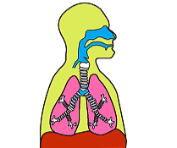
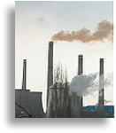
Percent Oxygen in Air
Lab Challenge
We get oxygen needed for respiration from the air around us. We hear on the news that the amount of greenhouse gases in the air is increasing. Obviously, air isn't only oxygen, but a mixture of different gases.
What percent of the molecules in air is oxygen?
Nose
Lungs
Mouth

Slide 4
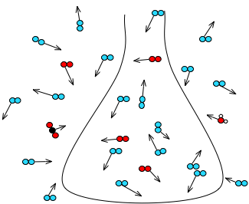
Percent Oxygen in Air
Background
Air is a mixture made of nitrogen molecules, oxygen molecules and a very small amount of other molecules such as carbon dioxide and water.
Gas molecules are in constant motion zipping through space and colliding into things.
oxygen, O₂
nitrogen, N₂
carbon dioxide, CO₂
water, H₂O
Air molecules inside and outside of a flask.

Slide 5
Percent Oxygen in Air
...Background
Force
Pressure is the average force spread over an area and is measured in the SI unit of Newton per square meter (N/m²), also known as a Pascal (Pa).
Air exerts pressure when the particles collide with their container.
Force
2
N
2 Newtons
Area
Air particles collide with force against the surface of their container.

Slide 6
Percent Oxygen in Air
...Background
Air pressure can change when 1) temperature, 2) volume, or 3) the amount of air particles changes.
Temperature:
When air is heated, the air particles move faster causing more collisions per second and thus increasing the pressure.
COLD
HOT

Slide 7
Percent Oxygen in Air
...Background
Volume:
When the volume of a container holding a gas increases, the pressure decreases. This is because the particles have more space to move around in and therefore collide with the container less often.
100 mL
500 mL
Amount of Air Particles:
3 molecules
7 molecules
If more particles are added, there will be more collisions and a correspondingly higher pressure.

Slide 8
Percent Oxygen in Air
Self-Check
Air is a ___________.
mixture
pure substance
compound
element
Notes:
L6 – text box
[ The best choice is … (tap here to enter text) ]

Slide 9
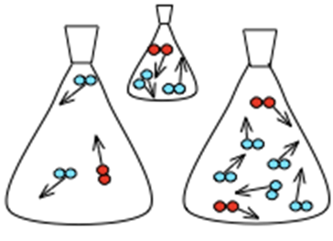
Percent Oxygen in Air
Self-Check
2. Which of the following does not affect air pressure?
temperature
the number of gas particles
the color of the gas
gas particles colliding with their container
the volume of the container
100 mL
500 mL
500 mL
Air inside flasks
Notes:
L6 – Text box
[ The best choice is … ]

Slide 10
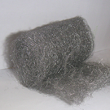
Percent Oxygen in Air
...Background
In this lab oxygen gas molecules will be removed from a container through the following reaction:
Oxygen gas (O₂) from the air reacts with iron (Fe) in steel wool to form rust (Fe₂O₃).
+
3 O₂(g) + 4 Fe(s) 2 Fe₂O₃(s)

Slide 11
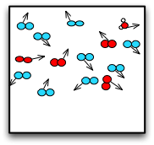
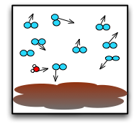
Percent Oxygen in Air
...Background
Oxygen as a reactant is a gas and contributes to the total pressure.
iron
iron and rust
iron and air
iron, air, and rust
After the reaction, oxygen combined with the iron to become a new substance, rust, which is a solid. This removal of oxygen will affect the gas pressure. Nitrogen and the other molecules in the air do not react with iron and just bounce off unchanged.

Slide 12
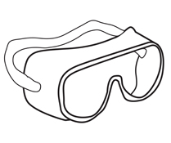
Percent Oxygen in Air
Safety
Follow all common laboratory safety procedures.
Vinegar is a weak acid. Avoid contact with the eyes and wash hands after handling glassware, steel wool, and equipment.
BE SAFE
Always wash hands to remove residue before leaving

Slide 13
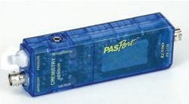
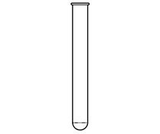
Percent Oxygen in Air
Materials and Equipment
Collect all of these materials before beginning the lab.
Data collection system
Absolute pressure sensor
Sensor extension cable
Quick-release connector
Tubing connector
Tubing (1-2 cm)
Test tube, 25-mm x 150-mm
One-hole stopper to fit test tube

Slide 14
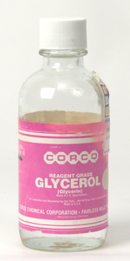
Percent Oxygen in Air
Materials and Equipment
Collect all of these materials before beginning the lab.
Stir rod
Beaker, 150-mL
Beaker, 500-mL
Steel wool, fine mesh, 1.0 g
White vinegar, 50-60mL
Glycerin, 2 drops
Paper towels
Glycerin

Slide 15
Percent Oxygen in Air
Sequencing Challenge
The steps to the left are part of the procedure for this lab activity. They are not in the right order. Determine the correct sequence of the steps, then take a snapshot of this page.
A. Create a closed container with air and steel wool and then start to collect pressure data.
B. Measure the initial and final pressure values and use them to calculate the percent oxygen in air.
C. Clean the steel wool with vinegar so that oxygen can react with the iron.
D. When the pressure stabilizes, stop collecting data.
Notes:
L6 – text box
[ The correct sequence of steps is … ]

Slide 16
Percent Oxygen in Air
Prediction
Q1: What will happen to the pressure inside the test tube as the reaction occurs? Draw your prediction on the graph provided.*
*To Draw a Prediction:
Tap to open the tool palette.
Tap then use your finger to draw your prediction.
Tap when finished.
If you make a mistake, tap to clear your prediction.

Slide 17
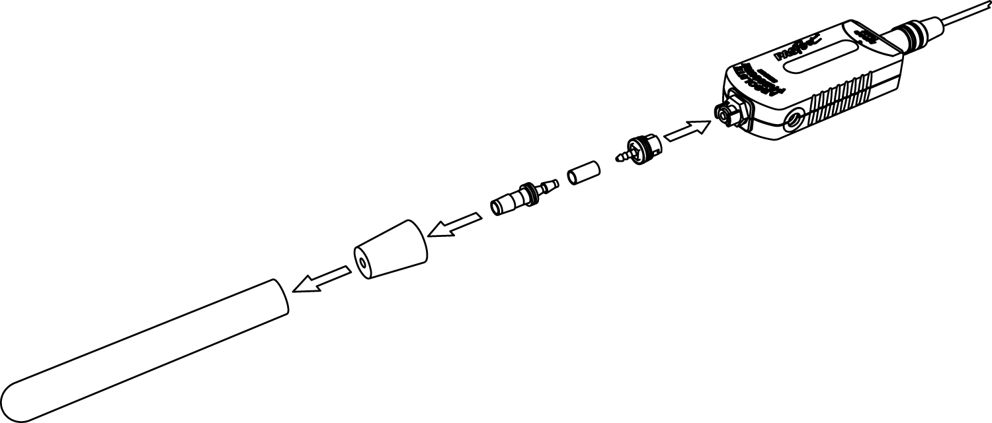
Percent Oxygen in Air
Setup
Connect the quick-release connector to the stopper using the tubing connector and the 1- to 2-cm piece of tubing. Put a drop of glycerin on the connectors as necessary.
Tubing connector
Quick-release
connector
Tubing
Stopper

Slide 18
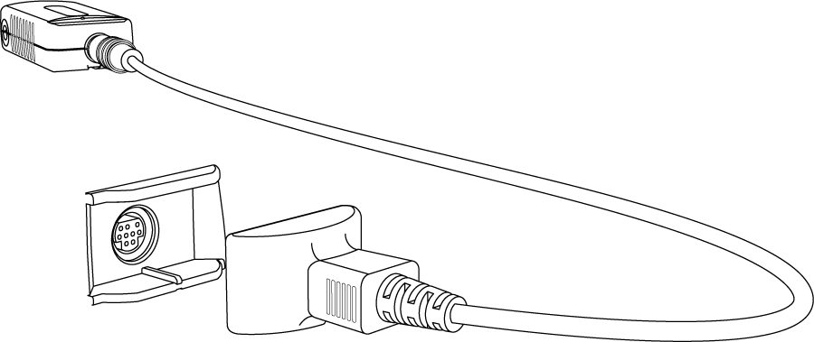
Percent Oxygen in Air
Setup
Connect the absolute pressure sensor to the data collection system using a sensor extension cable.
Pressure sensor
Extension cable

Slide 19
Percent Oxygen in Air
Setup
Insert the quick-release connector into the port of the absolute pressure sensor and then turn the connector clockwise until the fitting “clicks” (about one-eighth of a turn).

Slide 20
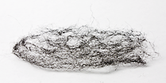
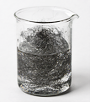
Percent Oxygen in Air
Setup
Obtain enough fine mesh steel wool to fill a large test tube about 2/3 full (about 1.0 g).
Stretch the steel wool apart so that a large amount of surface area is exposed.
Clean the steel wool by soaking it in a 150-mL beaker containing approximately 50 mL of vinegar for about one minute. Use a stir rod to fully rinse the steel wool in the vinegar.
Steel wool stretched out.
Steel wool soaking in vinegar.

Slide 21
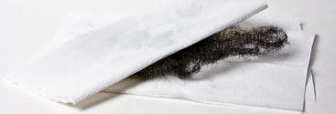
Percent Oxygen in Air
Setup
Q2:Why is it necessary to rinse the steel wool in vinegar?
Remove the steel wool from the beaker of vinegar and wring it out, draining the vinegar into the beaker.
Stretch apart the steel wool and thoroughly dry it with paper towels.
Notes:
L6 – text box
[ The steel wool needs to be rinsed in vinegar because … ]

Slide 22
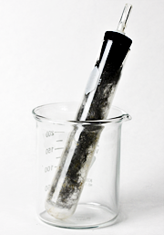
Percent Oxygen in Air
Setup
Stretch the steel wool apart and shake it in the air to make sure it is dry.
Put the steel wool in a large test tube making sure that a large surface area is still exposed. Do not pack the steel wool into the bottom of the test tube.
Note: You may have to gently tap the test tube to get the steel wool to slide down into the test tube.
Steel wool in a large test tube.

Slide 23
Percent Oxygen in Air
Collect Data
Place the stopper into the top of the test tube and tap to start collecting data.
Continue to the next page.

Slide 24
Percent Oxygen in Air
Q3: What is the dependent variable in this experiment? What unit is it measured in?
Notes:
L6 – text box
[ The dependent variable is … ]
[ It is measured in … ]

Slide 25
Percent Oxygen in Air
Q4: What is the independent variable in this experiment? What unit is it measured in?
Notes:
L6 – text box
[ The dependent variable is … ]
[ It is measured in … ]

Slide 26
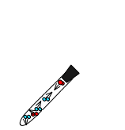
Percent Oxygen in Air
Q5: What molecules are contributing to the pressure you are recording? Be specific.
Notes:
L6- text box
[ The pressure is due to … ]
[ molecules of … ]

Slide 27
Percent Oxygen in Air
Q6: Write a sentence explaining the reaction occurring in the test tube. Explain where each substance comes from and its physical state (solid, liquid, or gas).
Notes:
L6 – text box
[ A reaction is occurring between … ]

Slide 28
Percent Oxygen in Air
Q7: What is happening to the pressure as the reaction occurs? Why?
iron
Notes:
L6 – text box
[ The pressure is … ]

Slide 29
Percent Oxygen in Air
Q8: List three changes you observe taking place in the test tube.
Notes:
L6 – text box
[ Three changes taking place in the test tube are … ]

Slide 30
Percent Oxygen in Air
Collect Data
When the pressure has stabilized (after about 20 to 30 minutes), tap to stop data collection.

Slide 31
Percent Oxygen in Air
Data Analysis
Determine the initial pressure, final pressure, and the change in pressure.*
Note: enter these values on the next page.
*To Find the Minimum and Maximum of a Run of Data:
Tap to open the tools palette.
Tap to open the Graph Statistics.
Choose Minimum and Maximum and tap OK.

Slide 32
Percent Oxygen in Air
Data Analysis
Record the initial pressure, final pressure, and the change in pressure.
Notes:
L6 – text box
[ Initial pressure … ]
[ Final pressure … ]
[ Change in pressure … ]

Slide 33
Percent Oxygen in Air
Data Analysis
Calculate the percent oxygen in air.
change in pressure (kPa)
x 100
initial pressure (kPa)
Notes:
L6 – text box
[ The percent oxygen in air is … ]

Slide 34
Percent Oxygen in Air
Analysis
Why did the pressure graph flatten out after a while? (Hint: think about what is happening to the amount of oxygen in the test tube.)
Notes:
L456 – text box
[ The pressure graph flattened out because … ]

Slide 35
Percent Oxygen in Air
Analysis
Why was the pressure not reduced to zero?
Notes:
L 456 – text box
[ The pressure did not make it to zero because … ]

Slide 36
Percent Oxygen in Air
Synthesis
Gases are often described as having no definite shape and filling the container they occupy. Explain what is happening at the molecular level to give gases these properties.
Notes:
L456 – text box
[ Gases have indefinite shape and fill the container they occupy because gas molecules … ]

Slide 37
Percent Oxygen in Air
Synthesis
Explain why solids have a definite shape.
Notes:
L456 – text box
[ Solids have a definite shape because molecules or atoms in a solid are … ]

Slide 38
Percent Oxygen in Air
Synthesis
Chemical reactions stop when one of the reactants is used up. This reactant is called the limiting reactant because it limits the amount of product that is made. In this lab, rust was the product. What was the limiting reactant?
Notes:
L456 – text box
[ The limiting reactant was … ]

Slide 39
Percent Oxygen in Air
Multiple Choice
Which of the following variables affects the pressure of a gas?
the number of gas molecules
the temperature of the gas molecules
the volume of the container the gas molecules are in
all of the above
100 mL
500 mL
500 mL
Air inside flasks
Notes:
L6 – text box
[ The best choice is … ]

Slide 40
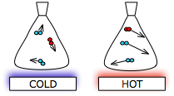
Percent Oxygen in Air
Multiple Choice
If you increase the temperature of a gas, what will happen to the pressure?
It will stay the same.
It will increase.
It will decrease.
There is not enough information to answer this question.
COLD
HOT
Notes:
L6 – text box
[ The best choice is … ]

Slide 41
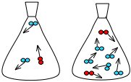
Percent Oxygen in Air
Multiple Choice
If you increase the number of gas molecules in a container, what will happen to the pressure?
It will stay the same.
It will increase.
It will decrease.
There is not enough information to answer this question.
Notes:
L6 – text box
[ The best choice is … ]

Slide 42
Percent Oxygen in Air
Multiple Choice
Approximately what percentage of air is made up of oxygen gas?
less than 5%
20%
70%
more than 80%
Notes:
L6 – text box
[ The best choice is … ]

Slide 43
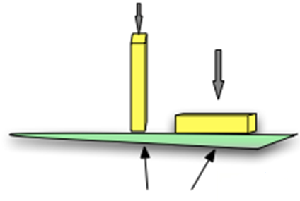
Percent Oxygen in Air
Multiple Choice
Pressure is best described as ___________.
a force spread over an area
the motion of molecules
the space between molecules in a gas
a strong force
Notes:
L6 – text box
[ The best choice is … ]

Slide 44
Percent Oxygen in Air
Congratulations!
You have completed the lab.
Please remember to follow your teacher's instructions for cleaning-up and submitting your lab.
Notes:
Color scheme (RGB values)
biology 121, 173, 54
chemistry 0 176, 216
physics 0, 102, 204
earth 204, 102, 0
middle 153, 102, 153
elementary 255, 51, 0

Slide 45
Percent Oxygen in Air
References
All images were taken from PASCO documentation, public domain clip art, or Wikimedia Foundation Commons
AIR POLLUTION http://commons.wikimedia.org/wiki/Image:Pollution_de_l%27air.jpg
MINI THERMOMETER http://freeclipartnow.com/small-icons/miscellaneous/thermometer-1.jpg.html
RUST http://commons.wikimedia.org/wiki/File:Oxid_%C5%BEelezit%C3%BD.PNG
CORROSIVE WARNING http://commons.wikimedia.org/wiki/Image:DIN_4844-2_Warnung_vor_Aetzenden_Stoffen_ D-W004.svg
BE SAFE http://freeclipartnow.com/signs-symbols/warnings/safety-hands.jpg.html
VINEGAR http://freeclipartnow.com/household/chores/cleaners/vinegar.jpg.html
BEAKER http://www.freeclipartnow.com/science/flasks-tubes/beaker-2.jpg.html
BEAKER http://freeclipartnow.com/science/flasks-tubes/beaker.jpg.htm

