Slide 1
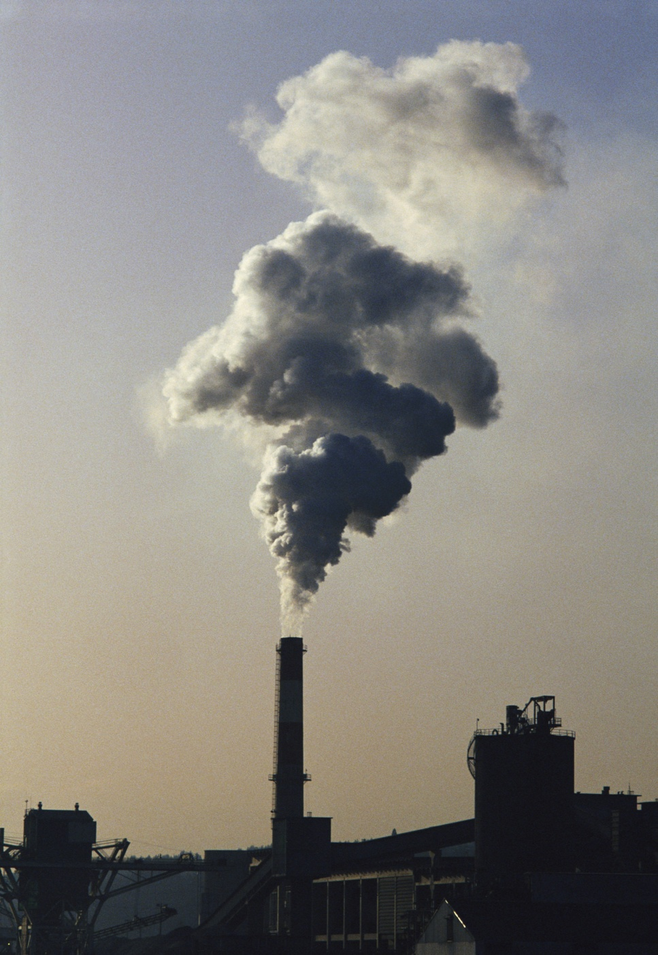
Air Pollution and Acid Rain
012-10988 r1.04

Slide 2
Air Pollution and Acid Rain
012-10750 r1.04

Slide 3
Air Pollution and Acid Rain
Introduction
Each page of this lab that contains the symbol
should be inserted into your journal. After completing a lab page with the snapshot symbol, tap (in the upper right hand corner) to insert the page into your journal.
Journals and Snapshots
The Snapshot button is used to capture the screen.
The Journal is where snapshots are stored and viewed.
The Share button is used to export or print your journal to turn in your work.
Note: You may want to take a
snapshot of the first page of
this lab as a cover page for
your journal.

Slide 4
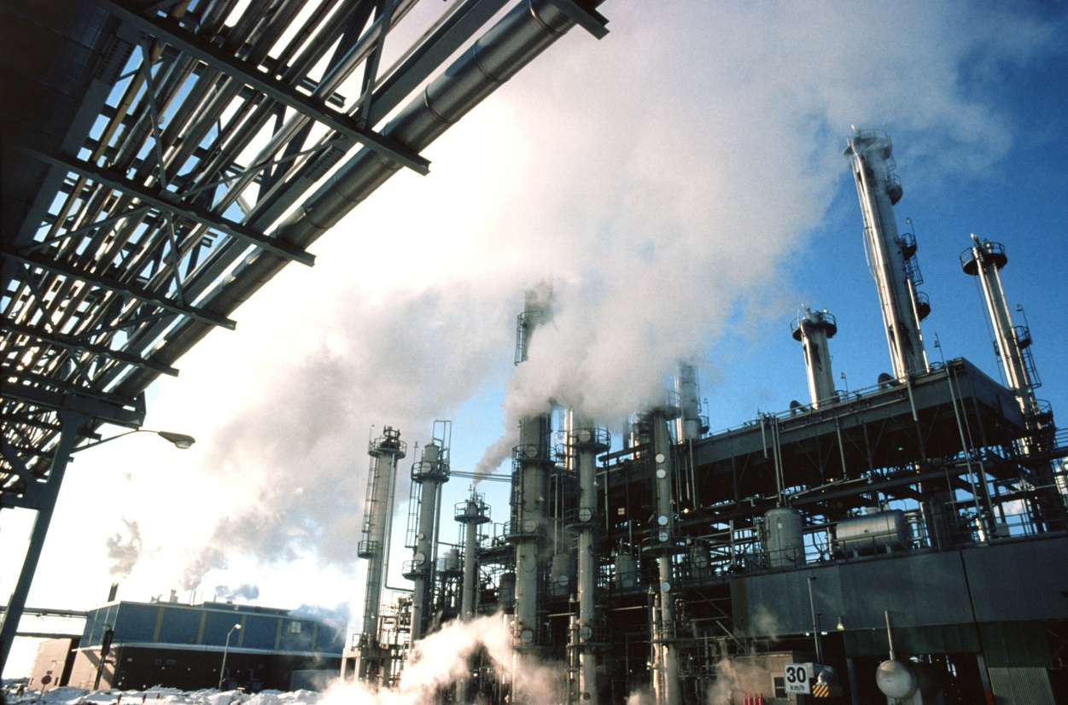
Air Pollution and Acid Rain
Lab Challenges
What is the connection between air pollution and acid rain?
How does acid rain affect the environment?

Slide 5
Air Pollution and Acid Rain
Background
Modern industry can cause a lot of pollution. Coal-burning power plants, automobiles, furnaces, and factories produce pollutant gases like sulfur dioxide (SO₂) and nitrogen oxides (including NO, NO₂, and N₂O).
Scientists have discovered that these gas pollutants are the primary causes of acid rain. Acid rain occurs when these gases react in the atmosphere with water, oxygen, and other chemicals to form various acidic compounds.
Acid rain causes acidification of lakes and streams and contributes to damage of trees at high elevations and many sensitive forest soils. In addition, acid rain accelerates the decay of building materials (including marble statues), stone, metals like bronze, and automotive paint.

Slide 6
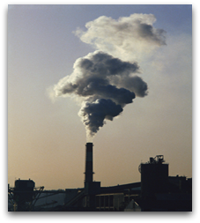
Air Pollution and Acid Rain
Self-Check
Acid rain is primarily caused by the pollutants like nitrogen oxides and...
soot
carbon dioxide
sulfur dioxide
pH water
elevator music
Notes:
L6 – Text box
[The best choice is…]

Slide 7
Air Pollution and Acid Rain
...Background
Acid rain produces stressful and sometimes deadly fluctuations in water systems causing aquatic life to experience chemical “shock” effects. For example, as the pH drops below 5.5, plankton, certain insects, and crustaceans begin to die and trout eggs do not hatch well.
Acid rain reduces crop productivity and forest growth rates and accelerates the rate at which metals and nutrients are leached from soils.
Scientists believe that acid rain can also cause increased concentrations of methylmercury dissolved in waterways. Methylmercury is a neurotoxic molecule that accumulates in fish tissues and can cause birth defects in populations that ingest high concentrations of fish.

Slide 8
Air Pollution and Acid Rain
Self-Check
Which of the following is LEAST affected by acid rain?
fish eggs
trees
crustaceans
dolphins
plankton
Notes:
L6 – Text box
[The best choice is…]

Slide 9
Air Pollution and Acid Rain
Safety
Use all standard laboratory safety procedures.
Keep water away from sensitive electronic equipment.
Use goggles and aprons/lab coats.
Do not touch the HCl used in this lab. Use a pipette to handle HCL.
In this lab you will create several chemical reactions in an Erlenmeyer flask. Do not remove the rubber stopper from the Erlenmeyer flask once each reaction has started.

Slide 10
Air Pollution and Acid Rain
Materials and Equipment
Collect all of these materials before beginning the lab.
pH sensor (1)
Erlenmeyer flask, 50-mL (1)
1-hole rubber stopper for flask (1)
Glass tubing for rubber stopper (1)
Flexible Teflon tubing to fit glass tubing, 20 cm (1)
Beaker 40-mL (1)
Graduated pipette & pipetting bulb
Graduated cylinder, 10- or 100-mL
Sodium bicarbonate (NaHCO3), 5 g
Sodium bisulfite (NaHSO3), 5 g
Sodium nitrite (NaNO2), 1.5 g
1 M HCl (15-mL)
Water or deionized water, 1 L
Wash bottle containing distilled or deionized water (1)
Materials shared across the class:
Electronic balance

Slide 11
Air Pollution and Acid Rain
Sequencing Challenge
The steps to the left are part of the procedure for this lab activity. They are not in the right order. Write the correct sequence below, then take a snapshot of this page.
A. Repeat gas generation and data collection.
B. Rinse out gas generation bottle, beaker, and tubing.
C. Generate CO₂ gas and collect data.
D. Determine changes in pH for each gas.
E. Set up equipment. Open graph display.
Notes:
L6 – Text box
[The correct sequence of steps is…]

Slide 12
Air Pollution and Acid Rain
Setup
Connect the pH sensor to your data collection system.
Ask your teacher if the pH sensor needs to be calibrated. If so, follow the instructions in blue on the next page. If not, go to step 3.
Put 20.0 mL of water into the 40-mL beaker.
Rinse the pH electrode with distilled water.
Note: This lab works best when completed by groups of at least two students.

Slide 13
Air Pollution and Acid Rain
To Calibrate the pH Sensor:
Note: Only calibrate the sensor if instructed to do so by your teacher.
Note: During the calibration process you will not be able to return to this page.
Calibration Point 1:
Place the pH probe in a pH 4 buffer solution.
Enter 4.0 as the pH in the Standard Value box under Calibration Point 1.
Tap Read From Sensor under Calibration Point 1.
Rinse the pH probe thoroughly using distilled water.
Calibration Point 2:
Repeat the process used in calibration point 1 using a pH 10 buffer solution.
Tap OK to exit the calibration screen and then tap OK again to return to the lab.
Open the Calibrate Sensor screens:
Tap
Tap CALIBRATE SENSOR
Ensure that the correct measurements are selected:
Sensor: (name of sensor)
Measurement: pH
Calibration Type: 2 point
Tap NEXT

Slide 14
Air Pollution and Acid Rain
Quick Overview
In this lab you'll be creating 3 gases: CO₂, SO₂, and NO₂. You will bubble these gases through water to see how they affect pH. You will mix
sodium bicarbonate (NaHCO₃) with hydrochloric acid (HCl) to produce carbon dioxide gas (CO₂).
sodium bisulfite (NaHSO3) with hydrochloric acid (HCl) to produce sulfur dioxide gas (SO₂).
sodium nitrite (NaNO₂) with hydrochloric acid (HCl) to produce nitrogen dioxide gas (NO₂).

Slide 15
Air Pollution and Acid Rain
Q1: If you bubble CO₂ gas into water, what will happen to the pH of the water?
Q2: If you bubble SO₂ gas into water, what will happen to the pH of the water?
Q3: If you bubble NO₂ gas into water, what will happen to the pH of the water?
Notes:
L 4 – Text box
[The pH of the water will…]
L5 – Text box
[The pH of the water will…]
L6 – Text box
[The pH of the water will…]

Slide 16
Air Pollution and Acid Rain
Procedure: CO₂ (g)
Obtain a sample of powdered sodium bicarbonate (NaHCO₃) from your teacher.
Measure out 5 grams of the NaHCO₃.
Place the NaHCO₃ in the Erlenmeyer flask.

Slide 17
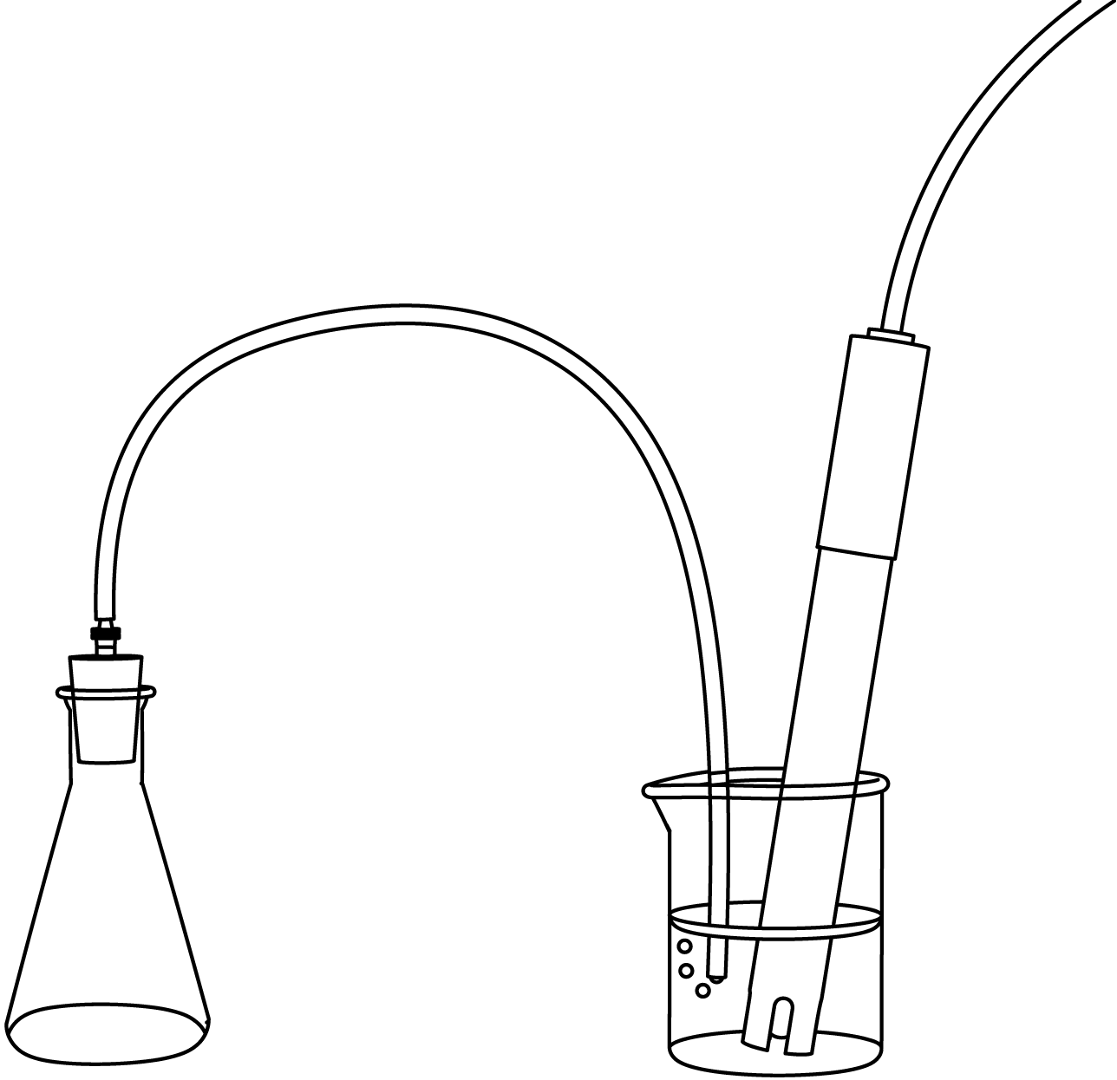
Air Pollution and Acid Rain
Procedure CO₂ (g)
Assemble the flask, stopper, glass tubing or barbed connector, and flexible tubing, using glycerin around the connections if necessary.
At this stage, one group member should hold the pH sensor and free end of the plastic tubing beneath the surface of the water in the beaker and tap the start button to begin collecting data. Another group member should quickly pipette 4 mL of 1.0 M hydrochloric acid (HCl) into the Erlenmeyer flask and immediately stopper the flask.
Use glycerin to lubricate the connection
pH sensor
Erlenmeyer flask
Continue to the next page.

Slide 18
Air Pollution and Acid Rain
Note: If the water in the tubing begins to flow backwards of if the bubbling stops, firmly grasp the Erlenmeyer flask in your hand so that the heat from your hand creates a higher pressure area in the flask. This should expel the gas into the water.
Record data for about 200 seconds (until the pH level stops changing and stabilizes), then stop the data set collection.

Slide 19
Air Pollution and Acid Rain
7. Determine maximum and minimum pH for the CO₂ experiment by analyzing its graph (previous page).*
8. Record these max/min values in the adjacent Data Table.
* To Find the Difference Between Two Data Points:
Tap to open the tools palette.
Tap and then tap two points on the data run.
Adjust using both buttons and then tap .
Tap to display the differences.
Notes:
In the Table, these are the column headings:
Col 1: [Name of the gas]
Col 2: [Maximum pH]
Col 3: [Minimum pH]

Slide 20
Air Pollution and Acid Rain
Procedure: CO₂ (g)
Dispose of the contents of the flask and beaker according to your teacher's instructions.
Thoroughly rinse the pH sensor electrode using distilled water from the wash bottle.
Rinse the beaker, Erlenmeyer flask, and tubing with tap water.

Slide 21
Air Pollution and Acid Rain
Procedure: SO₂ (g)
Measure 5g of sodium bisulfite (NaHSO₃).
Place the NaHSO₃ into the Erlenmeyer flask.
Reassemble the flask, stopper, glass tubing or barbed connector, and flexible tubing (same as for CO₂ run).
At this stage, one group member should hold the pH sensor and free end of the plastic tubing beneath the surface of the water in the beaker and tap the start button to begin collecting data. Another group member should quickly pipette 4 mL of 1.0 M hydrochloric acid (HCl) into the Erlenmeyer flask and immediately stopper the flask.

Slide 22
Air Pollution and Acid Rain
Note: If the water in the tubing begins to flow backwards of if the bubbling stops, firmly grasp the Erlenmeyer flask in your hand so that the heat from your hand creates a higher pressure area in the flask. This should expel the gas into the water.
Record data for about 200 seconds (until the pH level stops changing and stabilizes), then stop the data set collection.

Slide 23
Air Pollution and Acid Rain
Determine maximum and minimum pH for the SO2 experiment by analyzing its graph (previous page).*
Record these max/min values in the adjacent Data Table.
*To Enter Data into a Table:
1. Tap to open the tool palette.
2. Tap then tap a cell in the data table to highlight it in yellow.
3. Tap to open the Keyboard screen.
Notes:
In the Table, these are the column headings:
Col 1: [Name of the gas]
Col 2: [Maximum pH]
Col 3: [Minimum pH]

Slide 24
Air Pollution and Acid Rain
Procedure: SO₂ (g)
Dispose of the contents of the flask and beaker according to your teacher's instructions.
Thoroughly rinse the pH sensor electrode using distilled water from the wash bottle.
Rinse the beaker, Erlenmeyer flask, and tubing with tap water.

Slide 25
Air Pollution and Acid Rain
Procedure: NO₂ (g)
Measure 5 g of sodium nitrite (NaNO₂).
Place the NaNO₂ into the Erlenmeyer flask.
Reassemble the flask, stopper, glass tubing or barbed connector, and flexible tubing (same as for SO₂ run).
At this stage, one group member should hold the pH sensor and free end of the plastic tubing beneath the surface of the water in the beaker and tape the start button to begin collecting data. Another group member should quickly pipette 4 mL of 1.0 M hydrochloric acid (HCl) into the Erlenmeyer flask and immediately stopper the flask.

Slide 26
Air Pollution and Acid Rain
Note: If the water in the tubing begins to flow backwards or if the bubbling stops, firmly grasp the Erlenmeyer flask in your hand so that the heat from your hand creates a higher pressure area in the flask. This should expel the gas into the water.
Record data for about 200 seconds (until the pH level stops changing and stabilizes), then stop the data set collection.

Slide 27
Air Pollution and Acid Rain
Determine maximum and minimum pH for the NO₂ experiment by analyzing its graph (previous page).*
Record these max/min values in the adjacent Data Table.
*To Enter Data into a Table:
1. Tap to open the tool palette.
2. Tap then tap a cell in the data table to highlight it in yellow.
3. Tap to open the Keyboard screen.
Notes:
In the Table, these are the column headings:
Col 1: [Name of the gas]
Col 2: [Maximum pH]
Col 3: [Minimum pH]

Slide 28
Air Pollution and Acid Rain
Procedure: NO₂ (g)
Dispose of the contents of the flask and beaker according to your teacher's instructions.
Thoroughly rinse the pH sensor electrode using distilled water from the wash bottle.
Rinse the beaker, Erlenmeyer flask, and tubing with tap water.
Store all equipment according to your teacher's instructions.

Slide 29
Air Pollution and Acid Rain
Data Analysis
Calculate the change in pH for each gas experiment. Record in the adjacent table.
2. Snapshot page.
Save your work so far.
Notes:
In the Table, these are the column headings:
Col 1: [Name of the gas]
Col 2: [Maximum pH]
Col 3: [Minimum pH]
Col 4: [Change in pH]

Slide 30
Air Pollution and Acid Rain
Analysis
Were your three predictions about CO₂, SO₂, and NO₂ correct? Did the pH of the water change as you expected for each gas? Explain below.
Notes:
L456 – Text box
[My predictions were…]

Slide 31
Air Pollution and Acid Rain
Analysis
Use chemical notation to write a formula for the following reaction:
One molecule of carbon dioxide gas dissolves in water to form one bicarbonate ion and one hydrogen ion.
Notes:
L456 – Text box
[The formula is…]

Slide 32
Air Pollution and Acid Rain
Analysis
Use chemical notation to write a formula for the following reaction:
Two nitrogen dioxide gas molecules dissolve in water to form one nitrate ion, one nitrite ion, and two hydrogen ions.
Notes:
L456 – Text box
[The formula is…]

Slide 33
Air Pollution and Acid Rain
Analysis
Use chemical notation to write a formula for the following reaction:
One sulfur dioxide gas molecule dissolves in water to form one bisulfite ion and one hydrogen ion.
Notes:
L456 – Text box
[The formula is…]

Slide 34
Air Pollution and Acid Rain
Analysis
Which gas created the smallest change in pH of the water?
Notes:
L456 – Text box
[The gas that created the smallest change in the pH of the water was…]

Slide 35
Air Pollution and Acid Rain
Analysis
Compare your results with those from other groups. What factors might have caused some of the variability in change in pH observed?
Notes:
L456 – Text box
[Some factors that may have caused some variability in the change in pH are…]

Slide 36
Air Pollution and Acid Rain
Analysis
In the three reactions of gas dissolving in water in this lab, what is the cause of the reduction of the pH of the water in which these gases are dissolved?
Notes:
L456 – Text box
[The cause of reduction in the pH is…]

Slide 37
Air Pollution and Acid Rain
Synthesis
Use available resources to help you answer the following questions.
Which are considered the primary anthropogenic (man-made) gases that cause acid rain? What are some important sources of these gases?
Notes:
L456 – Text box
[The primary gases that cause acid rain are…]
[The primary sources are…]

Slide 38
Air Pollution and Acid Rain
Synthesis
Scientists have found that sulfuric acid is the primary acid involved in producing acid rain.
What are some of the chemical reactions that produce sulfuric acid in the atmosphere?
Why does radiation from the sun speed up this reaction?
Notes:
L456 – Text box
[Some of the chemical reactions are…]
[Radiation from the sun speeds this reaction because…]

Slide 39
Air Pollution and Acid Rain
Synthesis
Coal from states in the western United States, like Montana and Wyoming, has a lower percentage of sulfur impurities than coal found in the eastern United States. How would the burning of low-sulfur coal change acid rain?
Notes:
L456 – Text box
[Burning lower sulfur coal would…]

Slide 40
Air Pollution and Acid Rain
Synthesis
Discuss the relationship between acid rain and the sulfur and nitrogen cycles.
Notes:
L456 – Text box
[Sulfur and nitrogen in…]
[These molecules are then…]

Slide 41
Air Pollution and Acid Rain
Synthesis
5. What are some ways to treat the effects of acid rain?
Notes:
L456 – Text box
[Some ways to treat the effects of acid rain are to…]

Slide 42
Air Pollution and Acid Rain
Synthesis
What are some ways to prevent the formation of acid rain?
Notes:
L456 – Text box
[Some ways to prevent the formation of acid rain are to…]

Slide 43
Air Pollution and Acid Rain
Synthesis
Although carbonic acid produces only a small decrease in pH of water, why is it of concern in the environment?
Notes:
L456 – Text box
[Carbonic acid is a concern because…]

Slide 44
Air Pollution and Acid Rain
Multiple Choice
Which of the following is true about acid rain?
It is linked to NO_{x} and SO_{x} molecules in the atmosphere.
It can result in the death of many species of water-dwelling organisms when it causes the pH of lakes systems to move to a range outside their tolerance.
Affects soil chemistry and the ability of plant roots to take in nutrients.
Increases the mobility of toxic metals in ecosystems.
All of the above are true.
Only A, B, and C are true.
Notes:
L6 – Text box
[The best choice is…]

Slide 45
Air Pollution and Acid Rain
Multiple Choice
Which of the following play important roles in the formation of acid rain?
Solar radiation
Buffers in soils and water
Water in the atmosphere
Nitrogen gas (N₂) in the atmosphere
Only A and C
All of the above
Notes:
L6 – Text box
[The best choice is…]

Slide 46
Air Pollution and Acid Rain
Multiple Choice
In general, rain exerts harmful effects on ecosystems when it falls below a pH of ________.
3.5
4.5
5.5
6.5
7.5
Notes:
L6 – Text box
[The best choice is…]

Slide 47
Air Pollution and Acid Rain
Multiple Choice
Acid rain has been linked to __________.
contamination of fish with highly toxic methylmercury
damage to fish through reactions that create high aluminum concentrations in the water
reduced nutrient uptake by tree roots
weakening trees, so they become more susceptible to other types of damage
All of the above.
Notes:
L6 – Text box
[The best choice is…]

Slide 48
Air Pollution and Acid Rain
Congratulations!
You have completed the lab.
Please remember to follow your teacher's instructions for cleaning-up and submitting your lab.
Notes:
Color scheme (RGB values)
biology 121, 173, 54
chemistry 0 176, 216
physics 0, 102, 204
earth 204, 102, 0
middle 153, 102, 153
elementary 255, 51, 0

Slide 49
Air Pollution and Acid Rain
References
Images are taken from PASCO documentation, public domain clip art, or Wikimedia Foundation Commons.
http://www.freeclipartnow.com/office/paper-shredder.jpg.html

