Slide 1
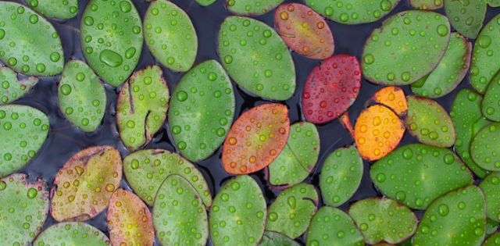
Monitoring the Quality of Water
012-10994 r1.04

Slide 2
Monitoring the Quality of Water
012-10762 r1.04

Slide 3
Monitoring the Quality of Water
Introduction
Each page of this lab that contains the symbol
should be inserted into your journal. After completing a lab page with the snapshot symbol, tap (in the upper right hand corner) to insert the page into your journal.
Journals and Snapshots
The Snapshot button is used to capture the screen.
The Journal is where snapshots are stored and viewed.
The Share button is used to export or print your journal to turn in your work.
Note: You may want to take a
snapshot of the first page of
this lab as a cover page for
your journal.

Slide 4
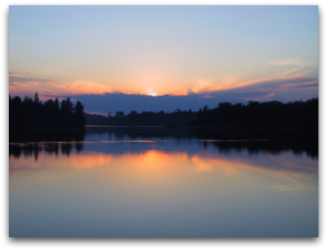
Monitoring the Quality of Water
Lab Challenges
Learn how to monitor the quality of a body of water in your area.
Explore how the water quality changes in response to changes in environmental factors.

Slide 5
Monitoring the Quality of Water
Background
Natural water bodies can have many chemical and physical characteristics, which can vary from one part of a body of water to another.
Depending on the characteristics of the watershed around the water body, as well as changes in weather, water quality indicators fluctuate. Water quality at a given point in a stream or river also reflects the effects of upstream activities.
We use measures of water quality to assess the health of a natural water body.

Slide 6
Monitoring the Quality of Water
Self-Check
Measuring the water quality at a particular place in a stream also gives information about __________________.
the water quality farther downstream.
the water quality in nearby rivers.
the water quality farther upstream.
Notes:
L6 – text box
[ The best choice is… ]

Slide 7
Monitoring the Quality of Water
...Background
Water quality is the suitability of water for a given use.
Water in a natural ecosystem has to have the right balance of dissolved oxygen, nutrients, temperature, pH, salt content, and light penetration to sustain a healthy aquatic ecosystem.
Drinking water must have acceptably low levels of contaminants to be deemed safe.
Treated wastewater must also be of acceptable quality before it is released back into the environment.

Slide 8
Monitoring the Quality of Water
Self-Check
Which of the following is NOT one of the measures of healthy natural water?
pH
temperature
sugar concentration
salt content
dissolved oxygen
Notes:
L6 – text box
[ The best choice is… ]

Slide 9
Monitoring the Quality of Water
...Background
The U.S. has standards for the quality of natural bodies of water that are deemed supportive of aquatic organisms. These standards are specified by the EPA (Environmental Protection Agency) in their Red Book and Gold Book.
The U.S. EPA also publishes the Primary and Secondary Drinking Water Standards on the Web. These standards specify the maximum level of contaminants that are lawful in the U.S. for drinking water supplied by municipal water treatment facilities.

Slide 10
Monitoring the Quality of Water
Safety
Follow all standard laboratory safety procedures.
Keep water away from sensitive electronic equipment.
This lab takes place outdoors, so practice appropriate caution around water bodies, steep terrain, and harmful plants or animals.

Slide 11
Monitoring the Quality of Water
Materials and Equipment
Collect all of these materials before beginning the lab.
Water quality sensor (pH, conductivity, temperature, dissolved oxygen)
Turbidity sensor (optional)
Weather sensor or barometric pressure sensor (optional)
Sensor Extension Cable
Large test tube (18 x 150 mm)
Beaker, 100-mL or larger
Pipette
Wide-mouth sampling jar or small plastic bucket
Long-handled sensor extension pole or meter stick
Labels and pens, duct tape
Towel
pH standards (pH 4 + pH 7 or 10)
Wash bottle containing distilled or deionized water
Lint-free laboratory tissue

Slide 12
Monitoring the Quality of Water
Sequencing Challenge
The steps to the left are PART A of the procedure for this lab activity. They are not in the right order. Write the correct sequence below, then take a snapshot of this page.
A. Collect a water sample from at least 1 meter away from the shore and from below the surface level of the water.
B. Measure the temperature, pH, conductivity, and dissolved oxygen of the water sample.
C. Find a suitable place to collect water samples. Note environmental conditions and appearance of water.
D. Determine barometric pressure. Calibrate pH and dissolved O₂ sensors before making measurements.
Notes:
L6 – text box
[ The correct sequence of steps for Part A is … ]

Slide 13
Monitoring the Quality of Water
Sequencing Challenge
The steps to the left are PART B of the procedure for this lab activity. They are not in the right order. Write the correct sequence below, then take a snapshot of this page.
A. (Optional) Map your test site locations and test values in GIS software such as My World GIS.
B. Find a second location on the water body and repeat the measurement procedure.
C. Measure the turbidity of the water. (optional)
Notes:
L6 – text box
[ The correct sequence of steps for Part B is … ]

Slide 14
Monitoring the Quality of Water
General Setup
Ask your teacher for advice on the best places to gather your water samples. You will need two locations about 5 meters apart.
Describe your locations in the space below. Refer to them as Site 1 and Site 2.
Notes:
L456 – text box
[ Site 1:]
[ Site 2:]

Slide 15
Monitoring the Quality of Water
General Setup
Using a sensor extension cable, connect the Water Quality Sensor to your data collection system. Make sure all four sensors are working as expected.
Make sure the conductivity sensor is adjusted to measure the quality of fresh (not salt) water. (Select the mid-range button on the sensor.)
Ask your teacher if you should calibrate the pH sensor (instructions on next page) and the dissolved oxygen (DO) sensor (Instructions follow next page).
Determine the 100% saturation point for the DO sensor with the sensor's storage bottle submerged in the water you plan to monitor. To do this you will need the barometric pressure of the air and the temperature of the water. Instructions for this are on page 16, but this may be optional. Ask your teacher.

Slide 16
Monitoring the Quality of Water
To Calibrate the pH Sensor:
Note: Only calibrate the sensor if instructed to do so by your teacher.
Note: During the calibration process you will not be able to return to this page.
Tap
Tap Calibrate Sensor
Measurement: select “pH”
Calibration Type: 2 point
Tap NEXT
Calibration Point 1:
Place pH probe in a pH 4 buffer solution.
Tap Read From Sensor under Calibration Point 1.
Remove pH 4 solution and rinse the pH probe thoroughly using distilled water.
3. Calibration Point 2:
Under Calibration Point 2, tap Standard Value and type in a pH 10 buffer solution.
Tap Read From Sensor under Calibration Point 2.
Tap OK to exit and then tap OK again to return to the lab.

Slide 17
Monitoring the Quality of Water
To Find the Barometric Pressure:
Note: This data is only necessary if you are calibrating the Dissolved Oxygen Sensor: check with your teacher.
Plug in the weather sensor or barometric pressure sensor.
Plug in the water quality multisensor with the temperature probe attached. Put the temperature probe into the water.
To start monitoring data, tap . When the values stabilize, tap . Use these data to find the standard DO value in the calibration tables.
Note: You can obtain barometric pressure from a classroom barometer or a weather website.
Notes:
Add a digits box.

Slide 18
Monitoring the Quality of Water
To Calibrate the Dissolved Oxygen (DO) Sensor:
Note: Only calibrate the sensor if instructed to do so by your teacher.
Note: During the calibration process you will not be able to return to this page.
Tap
Tap CALIBRATE SENSOR
Measurement: DO (mg/L)
4. For Calibration Type, select 1 point Adjust Slope Only.
Then tap NEXT.
Under the title, “Calibration Point 2”:
For standard value, use value from solubility table for correct barometric pressure and temperature.
Place 5 mL deionized water in clean soaker bottle and attach to probe.
Lower into stream and wait two minutes, then shake vigorously for 100% saturation.
Tap Read From Sensor.
Tap OK to exit the calibration screen and then tap OK again to return to the lab.
Note: It is important that water flow over the membrane in the sensor for the reading to be accurate.

Slide 19
Monitoring the Quality of Water
General Setup
Q1: Why was it necessary to determine the barometric pressure? (tap Q1 box to answer)
Q2: Why was it important to calibrate the Dissolved Oxygen sensor at the same temperature as the water you are testing? (tap Q2 box to answer, then take a snapshot)
Notes:
L3 – text box
[ Q1:]
L6 – text box
[ Q2:]

Slide 20
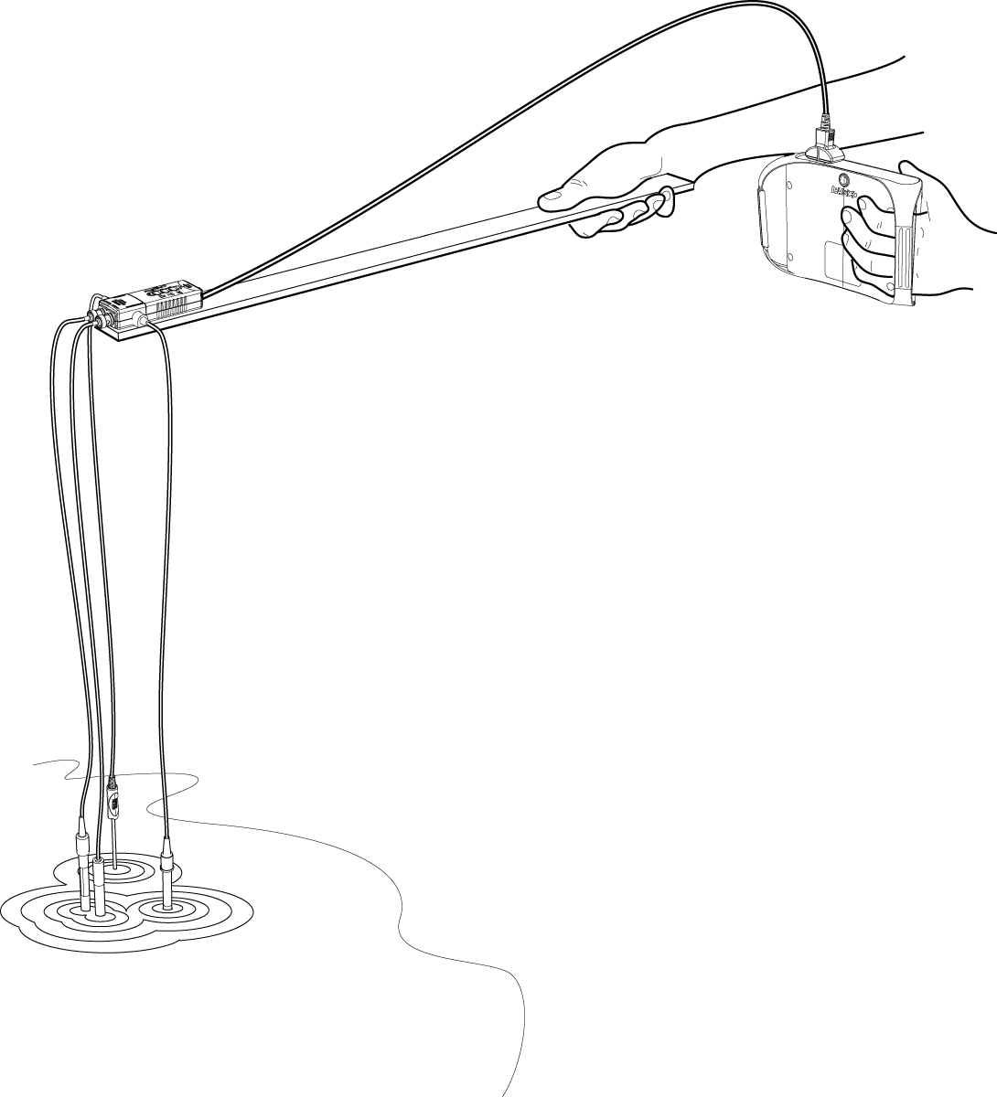
Monitoring the Quality of Water
Setup: Site 1 (in situ)
Use duct tape to secure the Water Quality Sensor to the sensor extension pole (or a meter stick). The actual probes should dangle below the tip of the pole so you can dip them in the water one meter out from the bank.
Gently lower the sensors into the water at least 1 meter from the shoreline so that they are submerged at least 1/3 meter below the surface of the water.
Important! Do not let the data collection system or the multisensor get wet! Only the probes should be submerged in the water.

Slide 21
Monitoring the Quality of Water
Procedure:
To start collecting data, tap on the next page.
Allow the readings to stabilize for at least two minutes.
If the water you are sampling is stagnant (not moving), slowly move the sensors back and forth in the water.
Then tap . (Each time you tap this button, data will be recorded for each probe.)
Walk to your next site and repeat steps 1 – 4.

Slide 22
Monitoring the Quality of Water
Notes:
Table with the four measurements

Slide 23
Monitoring the Quality of Water
Procedure: Site 2 (collected sample)
Now we will collect a sample of water from site 2 and test it back on shore. We do this to determine if different methods of sampling have any effect on our measurements.
Use duct tape to attach a clean bucket or other container to the end of the extension pole.
Collect a sample of water from approximately the same spot that you just monitored with the sensors (1 meter from shore, 1/3 meter below surface).
With the bucket placed securely on the ground, lower the probes into the water. Scroll back to the previous page and tap to begin collecting data.
To stop the data collection, tap .

Slide 24
Monitoring the Quality of Water
Procedure: Turbidity
5. Remove other sensors and connect the Turbidity Sensor. You will need to use a Connection Cable.
6. Calibrate the Turbidity Sensor according to the instructions in the user manual or instruction card.
7. Fill a cuvette with stream water from the bucket. Insert the cuvette into the meter. Follow the Tech Tip to collect data.*
8. Take a snapshot and save your work according to your instructor’s direction.
*Collecting Data:
Tap to begin collecting data.
Wait a few seconds for you reading to stabilize.
Tap to stop collecting data.
Notes:
Add a digits box.

Slide 25
Monitoring the Quality of Water
Wrap-Up
Save your data table on page 20 and take a snapshot of it for your journal.
Follow your teacher's instructions for cleaning up all equipment.
Add any final notes about the physical condition of the stream at either of your sites in the space below.
Notes:
[Further Notes]

Slide 26
Monitoring the Quality of Water
Analysis
1a. Was there a sizable difference between measurements made in situ and measurements made in the water sample?
1b. Do you think it is worth the effort to take measurements in situ?
Notes:
L456 – text box
[ The main differences were … ]
[ I think that … ]

Slide 27
Monitoring the Quality of Water
Analysis
What do you think could be responsible for any differences you found between sites?
Notes:
L456 – text box
[ Differences occur as a result of … ]

Slide 28
Monitoring the Quality of Water
Analysis
Dissolved oxygen levels below 3 mg/L indicate low water quality for many aquatic animals. Do you think the water you tested has enough dissolved oxygen to support most aquatic animals? Explain.
Notes:
L456 – text box
[ I think that … ]

Slide 29
Monitoring the Quality of Water
Analysis
Dissolved oxygen levels above 9 mg/L indicate eutrophication and low water quality. Rapid algae growth in nutrient-dense, warm water is usually responsible. Algae blooms are usually followed by very low DO levels because algae die and are decomposed by bacteria, which consume the DO during aerobic cellular respiration.
Does your water body show evidence of eutrophication? Explain.
Notes:
L456 – text box
[ Our water … ]
[ We know this because … ]

Slide 30
Monitoring the Quality of Water
Analysis
Consider the pH levels from your data. Does your water body show signs of acid rain or other acid deposition? Explain.
Notes:
L456 – text box
[ Our water … ]

Slide 31
Monitoring the Quality of Water
Analysis
Conductivity is a measure of salts dissolved in the water. Conductivity levels in a surface water body above 200 to 300 µS/cm may indicate pollution by runoff from cities or agricultural regions.
Does your water body show signs of pollution? If so, what do you think might be contributing to this pollution?
Notes:
L456 – text box
[ Our water … ]

Slide 32
Monitoring the Quality of Water
Analysis
In the United States, turbidity levels higher than 1 NTU in drinking water are unlawful . If your water body serves as a drinking water source, would the water have to be filtered to remove suspended solids? Explain.
Notes:
L456 – text box
[ Our water … ]

Slide 33
Monitoring the Quality of Water
Synthesis
Use available resources to help you answer the following questions.
Design an additional study to determine levels of pollutants in the water body you tested. Use evidence you collected in the field study to identify 3 additional tests that would be useful to conduct.
Explain why you picked these tests.
Notes:
L456 – text box
[ An additional thing I would like to study is … ]
[ because … ]

Slide 34
Monitoring the Quality of Water
Synthesis
Design a water quality monitoring process to test whether a point-source polluting entity is significantly affecting your water body.
Examples of point-source pollution include heat from power plants, nitrogen, phosphates, or salts from agricultural or urban runoff, and treated or untreated sewage.
Notes:
L456 – text box
[ Our process includes … ]

Slide 35
Monitoring the Quality of Water
Multiple Choice
Which of the following describes a watershed?
It delivers runoff, sediment, and dissolved substances into the water body.
A coastal delta is an example.
An inland floodplain is an example.
It is the land area bordering a water body.
A and D.
Notes:
L6 – text box
[ The best choice is … ]

Slide 36
Monitoring the Quality of Water
Multiple Choice
Point-source pollution __________.
can usually be identified within a given area
is dispersed and difficult to identify
is more easily controlled than nonpoint- source pollution
A and C
A, B, and C
Notes:
L6 – text box
[ The best choice is … ]

Slide 37
Monitoring the Quality of Water
Multiple Choice
Fish kills can be caused by __________.
decreased dissolved oxygen levels due to decomposition of sewage by bacteria
decreased dissolved oxygen levels due to high summer temperatures
excessive cultural eutrophication followed by decomposition by bacteria
A and C
A, B, and C
Notes:
L6 – text box
[ The best choice is … ]

Slide 38
Monitoring the Quality of Water
Multiple Choice
Nitrates, potassium, and phosphorous that are found in plant fertilizers are considered water pollutants because they __________.
directly reduce the dissolved oxygen in water
form toxic compounds in water
result in increased algae growth rates
are harmful to fish and humans
None of the above.
Notes:
L6 – text box
[ The best choice is … ]

Slide 39
Monitoring the Quality of Water
Multiple Choice
Eutrophication can be caused by __________.
plant nutrients found in fertilizers
organic wastes from waste treatment facilities
human recreational activities such as swimming or boating
A and B
All of the above.
Notes:
L6 – text box
[ The best choice is … ]

Slide 40
Monitoring the Quality of Water
Multiple Choice
Bodies of water that are eutrophic typically exhibit __________.
higher turbidity
high nutrient levels
low turbidity
a low level of primary productivity
A and B
Notes:
L6 – text box
[ The best choice is … ]

Slide 41
Monitoring the Quality of Water
Congratulations!
You have completed the lab.
Please remember to follow your teacher's instructions for cleaning-up and submitting your lab.
Notes:
Color scheme (RGB values)
biology 121, 173, 54
chemistry 0 176, 216
physics 0, 102, 204
earth 204, 102, 0
middle 153, 102, 153
elementary 255, 51, 0

Slide 42
Monitoring the Quality of Water
References
Images are taken from PASCO documentation, public domain clip art, or Wikimedia Foundation Commons.
http://www.freeclipartnow.com/office/paper-shredder.jpg.html
Sunset Photo and Lily Pond Photo Copyright Matt Fishbach 2008, royalty free for use for Pasco Scientific
Frog (stylized by MattFish). http:www.freeclipartnow.com/animals/frogs/pickerel-frog.jpeg.html

