Slide 1
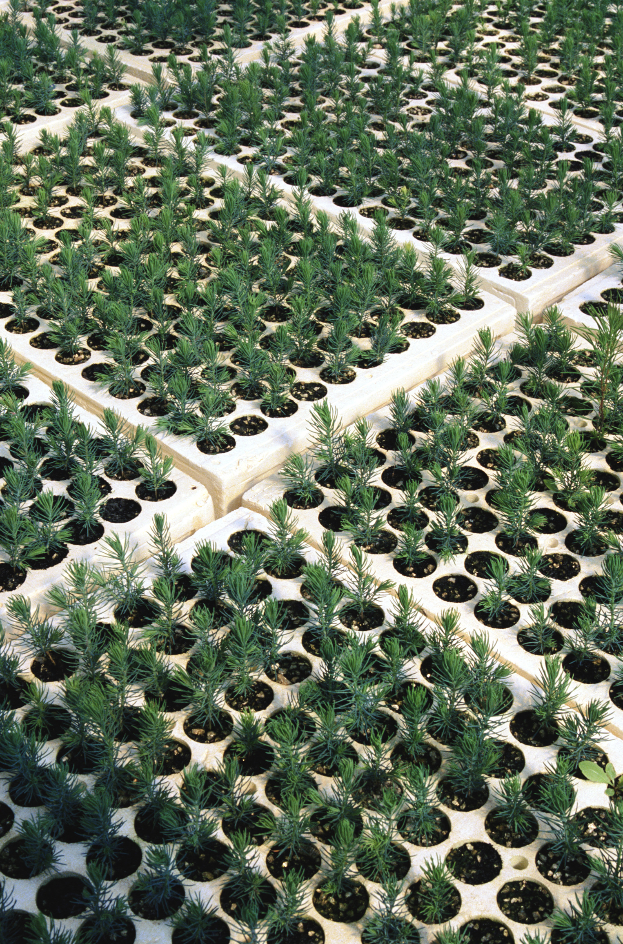
Soil pH
012-10995 r1.04

Slide 2
Soil pH
012-10764 r1.04

Slide 3
Soil pH
Introduction
Each page of this lab that contains the symbol
should be inserted into your journal. After completing a lab page with the snapshot symbol, tap (in the upper right hand corner) to insert the page into your journal.
Journals and Snapshots
The Snapshot button is used to capture the screen.
The Journal is where snapshots are stored and viewed.
The Share button is used to export or print your journal to turn in your work.
Note: You may want to take a
snapshot of the first page of
this lab as a cover page for
your journal.

Slide 4
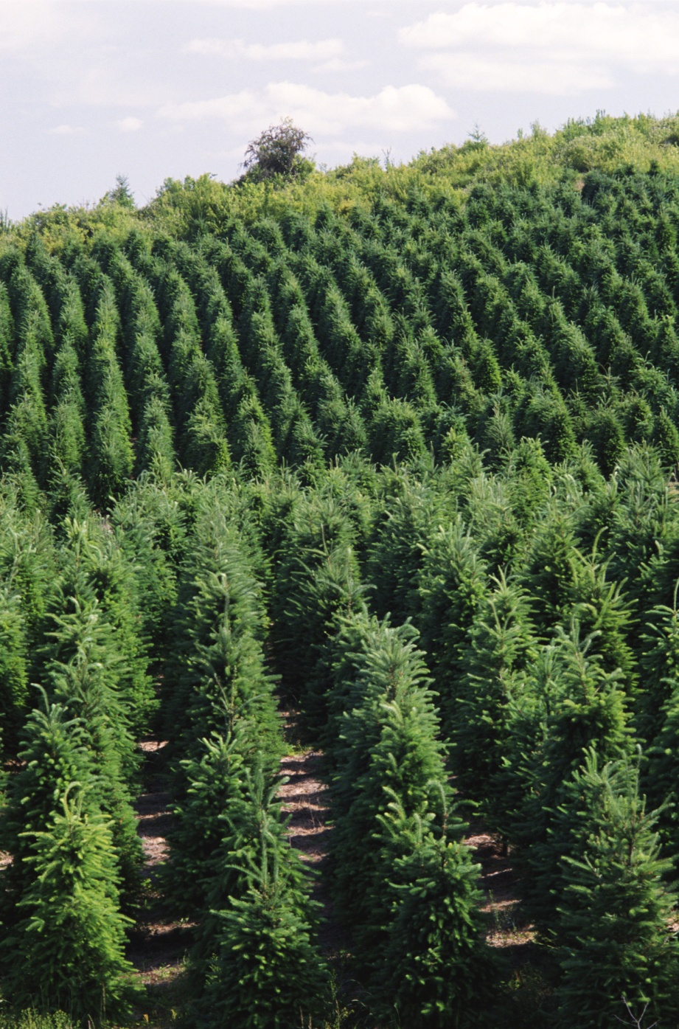
Soil pH
Lab Challenge
How healthy is your soil?
What is soil pH?
How does soil pH impact the plants it supports?
What causes changes in soil pH?

Slide 5
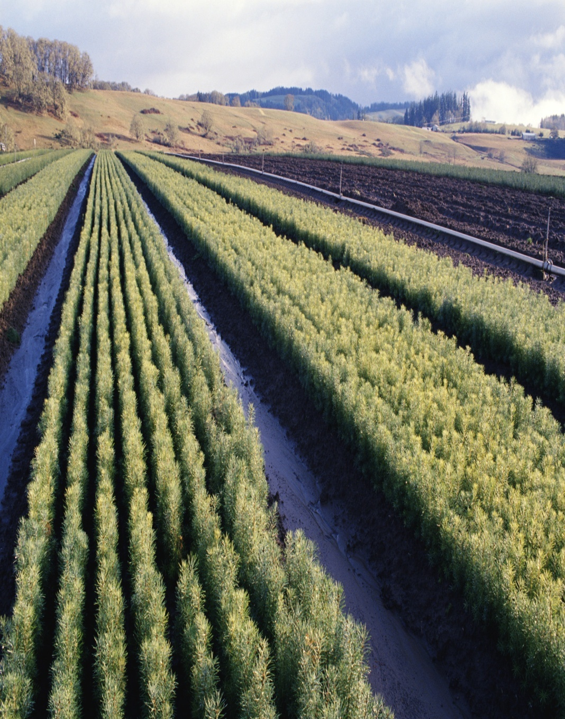
Soil pH
Background
Soils are complex combinations of inorganic materials (not carbon-based), organic materials (carbon-based), and living organisms.
Various combinations of these materials can yield soils that are infertile (no plant growth), semi-fertile (some plant types will grow but others will not) and very fertile (most plant types will grow in it).

Slide 6
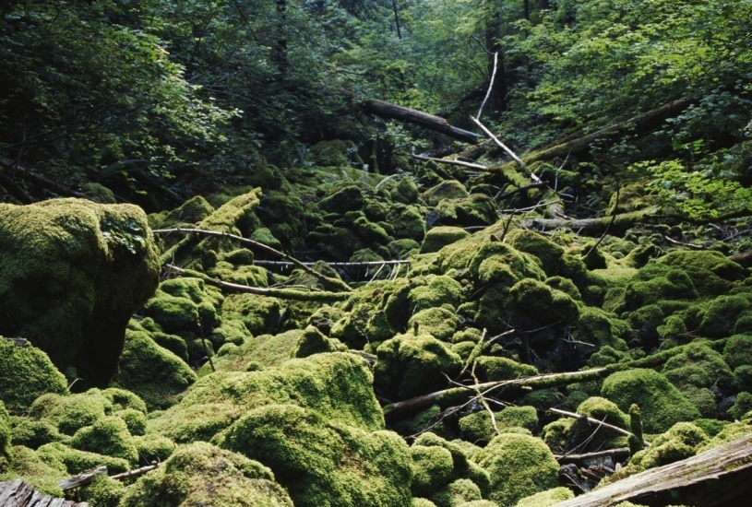
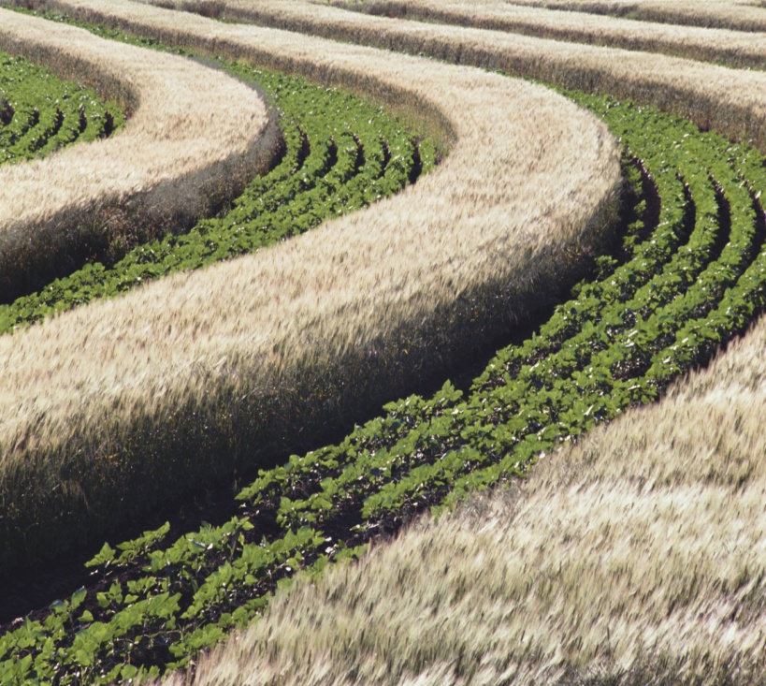
Soil pH
...Background
Soil that supports plant growth has many characteristics:
Porous, allowing air and water to filter through.
Contains lots of humus (dead plant material), which retains moisture needed for new plant growth.
Has a pH that is in the neutral zone (pH of 6 to 7.5) and can resist changes in pH.
Does not contain too much salt.
Has a thriving population of decomposers (earthworms, ants, beetles, fungi, bacteria, etc.) that break down materials to the smallest building blocks that can be used by plants for growth.

Slide 7
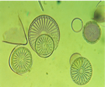
Soil pH
Self-Check
What important role do decomposers play in establishing healthy soil?
They digest smelly dead things.
They break down dead organic matter into nutrients usable by plants.
They shed calories.
All of the above.
Notes:
L6 – Text box
[The best choice is…]

Slide 8
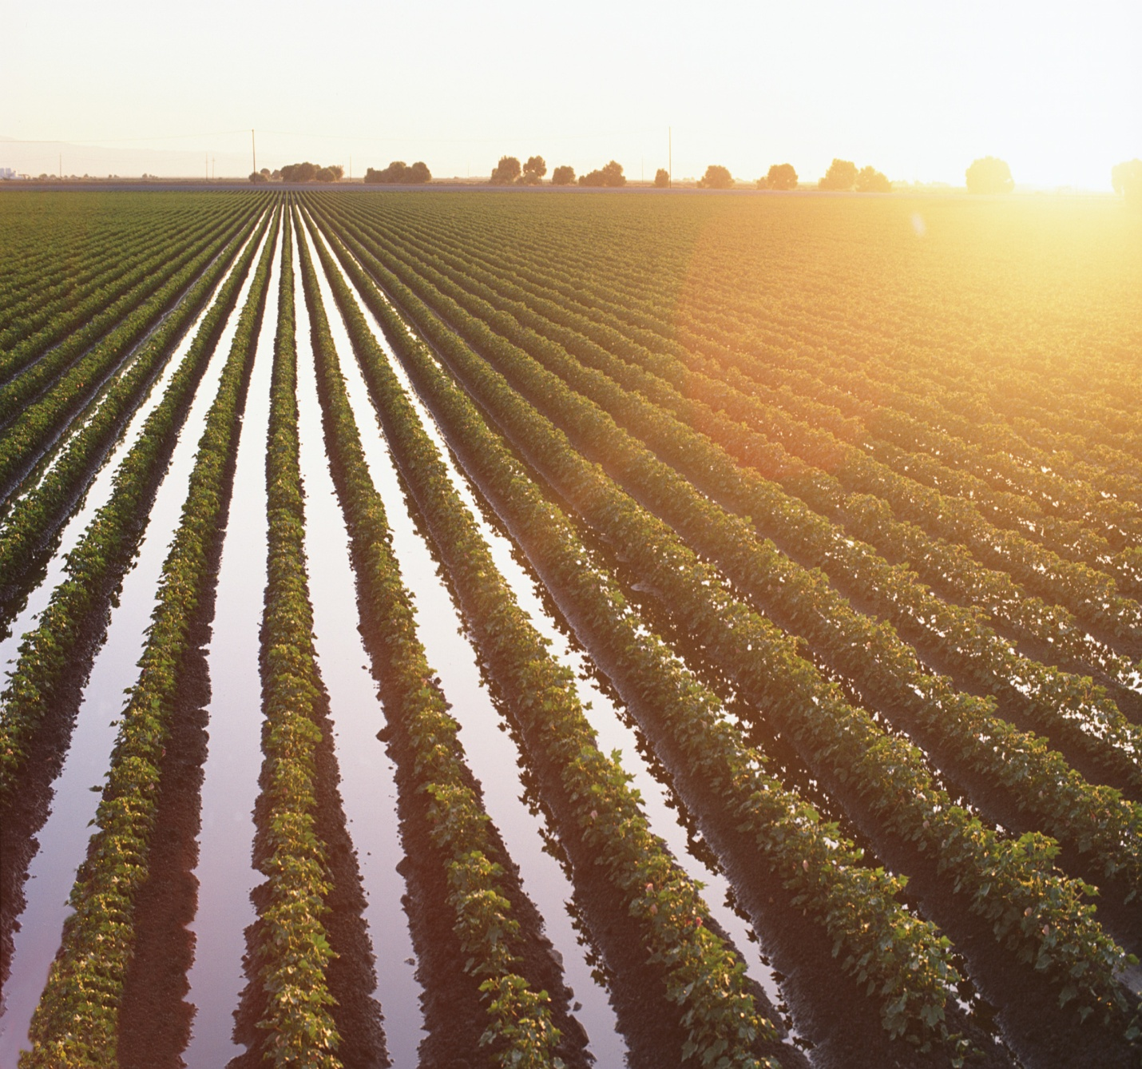
Soil pH
...Background
Soils are a vital part of the ecosystem, providing support for terrestrial plant growth.
Plants comprise an important segment of primary productivity on which all living beings ultimately depend for food.
Plants and decomposers are vital links in the global cycles of water, carbon, oxygen, nitrogen, sulfur, and other elements that are required for growth.

Slide 9
Soil pH
Self-Check
2. Explain how soils are important to primary productivity.
Notes:
L456 – Text box
[Soils are important to primary productive because…]

Slide 10
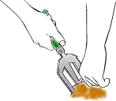
Soil pH
Safety
Follow all standard laboratory safety procedures.
Do not select soil samples in areas high in animal wastes.
Do not take samples from private property without permission.

Slide 11
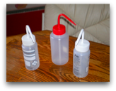
Soil pH
Materials and Equipment
Collect all of these materials for your group.
Materials shared across the class.
pH sensor
Beaker, 100-mL (4 per group)
Plastic zip lock bag (3)
Graduated cylinder, 100-mL
Beaker, 100-mL (4)
Digging tool
Stirring rod
pH standard solutions (pH 4 and pH 10)
Wash bottle containing deionized or distilled water
Waste container
Permanent marker
Paper towels

Slide 12
Soil pH
Sequencing Challenge
The steps to the left are part of the procedure for this lab activity. They are not in the right order. Determine the correct sequence of the steps, then take a snapshot of this page.
A. Wait for your measurement to stabilize and record the pH value in a data table. Repeat for additional soil samples.
B. Rinse the pH probe with distilled water, then use it to determine the pH of the soil sample.
C. Crush a dry soil sample into a fine dust and mix with water.
D. Calibrate the pH sensor.
Notes:
L6 – Text box
[The correct sequence of steps is…]

Slide 13
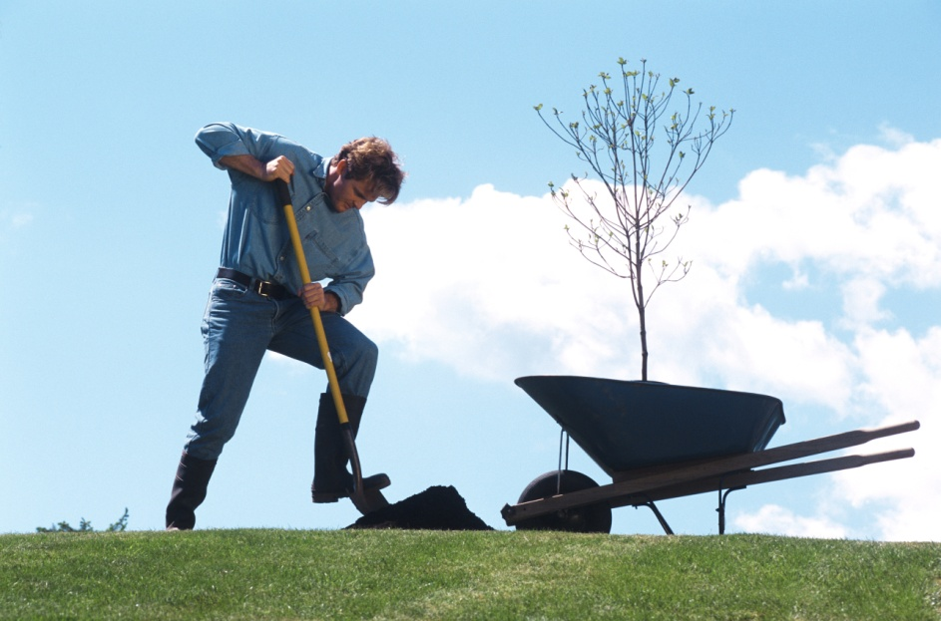
Soil pH
Setup
Using the digging tool, gather 3 soil samples from different locations. If possible, find soils that differ in appearance, composition, and in the type of plants growing nearby.
Place each sample into a plastic bag and seal and label it.
Use the next three pages to record field notes about each of your soil samples.
Note: Give each sample a label, describe its appearance, and describe what kinds of plants are growing nearby.
4. Take a snapshot of each page of your field notes.

Slide 14
Soil pH
Notes:
L123456 – Text box
Col 1: [Soil Sample 1: (snapshot this page when complete), Location:, Date/Time Collected:, Appearance/Composition:, Description of Nearby Plants:]

Slide 15
Soil pH
Notes:
L123456 – Text box
Col 1: [Soil Sample 2: (snapshot this page when complete), Location:, Date/Time Collected:, Appearance/Composition:, Description of Nearby Plants:]

Slide 16
Soil pH
Notes:
L123456 – Text box
Col 1: [Soil Sample 3: (snapshot this page when complete), Location:, Date/Time Collected:, Appearance/Composition:, Description of Nearby Plants:]

Slide 17
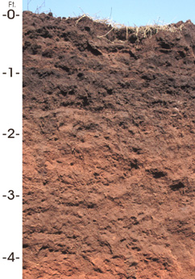
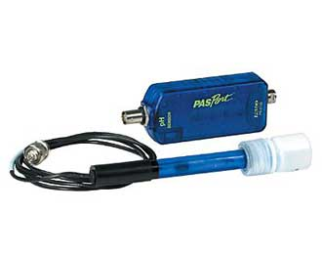
Soil pH
Setup
Crush each of the soil samples into as fine a dust as possible. Remove any rocks, sticks, etc.
Plug the pH sensor into your Spark Science Learning System.
Calibrate the pH Sensor according to the instructions on the next page.

Slide 18
Soil pH
To Calibrate the pH Sensor:
Calibration Point 1:
Place the pH probe in a pH 4 buffer solution.
Enter 4.0 as the pH in the Standard Value box under Calibration Point 1.
Tap Read From Sensor under Calibration Point 1.
Rinse the pH probe thoroughly using distilled water.
Calibration Point 2:
Repeat the process used in calibration point 1 using a pH 10 buffer solution.
Tap OK to exit the calibration screen and then tap OK again to return to the lab.
Note: During the calibration process you will not be able to return to this page.
1. Open the Calibrate Sensor screens:
Tap
Tap CALIBRATE SENSOR
2. Ensure that the correct measurements are selected:
Sensor: (name of sensor)
Measurement: pH
Calibration Type: 2 point
Tap NEXT

Slide 19
Soil pH
Setup
Label 3 of the beakers as "Sample 1," "Sample 2," and "Sample 3.“ Label the fourth beaker “Control”.
Add about 60 mL (4 tablespoons) of each of your soil samples into the corresponding labeled beaker.
Add about 60 mL of distilled water into each beaker, including the Control.
Mix the soil and water thoroughly in each beaker. Clean your stirring rod between each beaker to avoid cross-contamination.
Allow the muddy mixtures to sit for approximately 5 minutes.

Slide 20
Soil pH
Procedure
Rinse the pH probe with distilled water, then slowly swirl it in the Soil 1 mixture.
Tap to activate the sensor display.
When the pH value has stabilized, tap to freeze the display, then record the pH value in the box to the right.
Repeat steps 1-3 using Soil Samples 2 and 3.
Rinse the sensor thoroughly and test the Control.
Save your work then follow your teacher's instructions for cleaning up.
Notes:
L6 – Text box
[Sample 1 =]
[Sample 2 =]
[Sample 3 =]
[Control =]

Slide 21
Soil pH
Data Analysis
1. Which factors did you attempt to control in the 3 trials?
Notes:
L456 – Text box
[The factors I attempted to control were…]

Slide 22
Soil pH
Data Analysis
2. What was the independent variable? What was the dependent variable?
Notes:
L456 – Text box
[The independent variable was…]
[The dependent variable was…]

Slide 23
Soil pH
Analysis
1. Based on the pH values of your soils, what possible conclusions might you make about the parent materials that the soil is derived from?
Notes:
L456 – Text box
[I can conclude that…]

Slide 24
Soil pH
Analysis
2. Which of the three soil solutions was more acidic? Explain why it might have a higher pH compared to the other samples.
Notes:
L456 – Text box
[The most acidic soil was…]
[because…]

Slide 25
Soil pH
Analysis
3. Which of the three soil solutions was more alkaline? Explain why it might have a higher pH compared to the other samples.
Notes:
L456 – Text box
[The most alkaline soil was…]
[because…]

Slide 26
Soil pH
Synthesis
Based on the pH results only, would your soils be capable of supporting a healthy agricultural crop? List a crop that would prefer the pH environment recorded for each of your soil samples.
Notes:
L456 – Text box
[Based on the pH testing, the soils…]

Slide 27
Soil pH
Synthesis
What earth materials are useful in buffering soil pH levels? Describe what you could add to adjust the pH of soil samples.
Notes:
L456 – Text box
[Some materials that are useful for buffering are…]
[To adjust the pH of the soil samples, I could add…]

Slide 28
Soil pH
Multiple Choice
What changes may result from the change in pH of a soil?
Growth of soil microorganisms.
Solubility of toxic substances in the soil.
Availability of mineral nutrients.
All of the above.
Notes:
L6 – Text box
[The best choice is…]

Slide 29
Soil pH
Multiple Choice
What result does the decrease in soil pH typically have?
Release of toxic metals such as Al, Fe, Mn, and Ni.
Deficiencies of micronutrients such as B, Fe, and Mn.
Release of calcium carbonate.
Increase in salts.
Notes:
L6 – Text box
[The best choice is…]

Slide 30
Soil pH
Congratulations!
You have completed the lab.
Please remember to follow your teacher's instructions for cleaning-up and submitting your lab.
Notes:
Color scheme (RGB values)
biology 121, 173, 54
chemistry 0 176, 216
physics 0, 102, 204
earth 204, 102, 0
middle 153, 102, 153
elementary 255, 51, 0

Slide 31
Soil pH
References
All images were taken from PASCO documentation, public domain clip art, or Wikimedia Foundation Commons:
http://commons.wikimedia.org/wiki/File:PHscalenolang.png
http://commons.wikimedia.org/wiki/File:Oklahoma_state_soil.JPG
http://commons.wikimedia.org/wiki/File:Measuring_cylindertrue_colour.png
http://commons.wikimedia.org/wiki/File:Washbottles.JPG
http://www.freeclipartnow.com/office/paper-shredder.jpg.html
http://www.designedtoat.com/garden2.shtml

