Slide 1
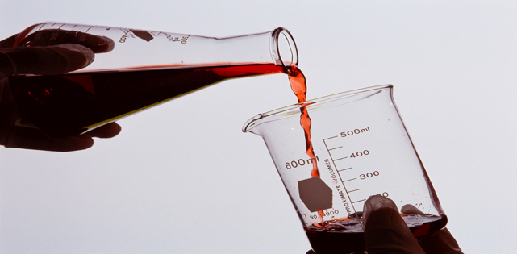
Evidence of a Chemical Reaction
012-10742 r1.04

Slide 2
Evidence of a Chemical Reaction
Introduction
Each page of this lab that contains the symbol
should be inserted into your journal. After completing a lab page with the snapshot symbol, tap (in the upper right hand corner) to insert the page into your journal.
Journals and Snapshots
The Snapshot button is used to capture the screen.
The Journal is where snapshots are stored and viewed.
The Share button is used to export or print your journal to turn in your work.
Note: You may want to take a
snapshot of the first page of
this lab as a cover page for
your Journal.

Slide 3
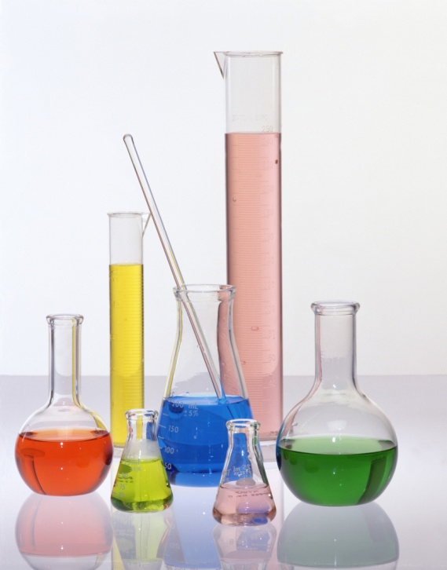
Evidence of a Chemical Reaction
Lab Challenges
Matter is constantly changing all around us. Some changes create new chemical substances while others only change a substance’s appearance. The creation and identification of new products relies on being able to determine if a chemical reaction has occurred. By the end of this activity you will be able to:
Distinguish between physical changes and chemical reactions using the evidence that suggests a new chemical reaction has occurred.
Identify the reactants and products in a chemical reaction.
Differentiate between exothermic and endothermic chemical reactions.

Slide 4
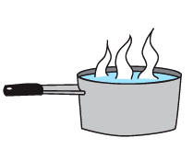
Evidence of a Chemical Reaction
Background
Chemistry is the study of matter and how it changes. Matter, which is made up of atoms, can change both physically and chemically.
A physical change occurs when the physical appearance of a substance changes but the chemical identity of the substance remains the same.
Boiling Water
H₂O (l)
H₂O (g)

Slide 5
Evidence of a Chemical Reaction
...Background
A chemical change, also called a chemical reaction, occurs when a new chemical substance is formed.
Reactants
Products
C₁₂H₂₂O₁₁ ₊ 12 O₂ → 12 CO₂ + 11 H₂O + Energy
(12)
(12)
(11)
Combustion (burning)
sucrose + oxygen → carbon dioxide + water
The atoms that make up the reactants rearrange to form new molecules (the products).

Slide 6
Evidence of a Chemical Reaction
Self-Check
What is another name for a chemical change?
physical change
chemical reaction
phase change
loose change
oxidation reaction
Notes:
L6 – text box
[ The best choice is … (tap here to enter text) ]

Slide 7
Evidence of a Chemical Reaction
...Background
There are four primary types of evidence that indicate a chemical reaction has occurred. They are:
The formation of a gas
A significant change in color
A change in temperature
The formation of a precipitate
(a solid formed when two aqueous solutions are mixed)
These types of evidence indicate that a chemical change, a rearrangement of molecules, has probably occurred.

Slide 8
Evidence of a Chemical Reaction
Self-Check
Which is NOT considered evidence for a chemical reaction?
formation of a precipitate
change in temperature
formation of a gas
change in phase
significant change in color
Notes:
L6 – text box
[ The best choice is … ]

Slide 9
Evidence of a Chemical Reaction
...Background
Chemical reactions that release heat into the surroundings are called exothermic reactions.
Example of Burning
Temperature increases as the reaction occurs.
Chemical reactions that absorb heat from their surroundings are called endothermic reactions.
Example of Instant Cold Pack
Temperature decreases as the reaction occurs.

Slide 10
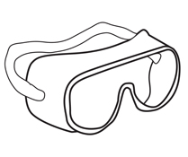
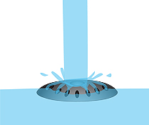
Evidence of a Chemical Reaction
Safety
Use all standard laboratory safety procedures.
The silver nitrate (AgNO₃) solution in this lab may temporarily stain your skin when exposed to bright light. If the solution contacts your skin, wash immediately with soap and water.
Many chemicals used in this lab are hazardous to the environment and should not be disposed of down the drain. Follow your teacher’s instruction on how to properly dispose of the chemicals.
Be careful with hot water and hot lab equipment!
HOT!!

Slide 11
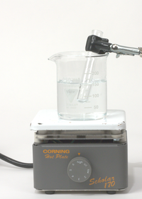
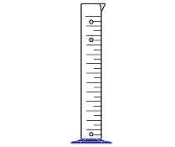
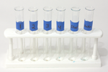
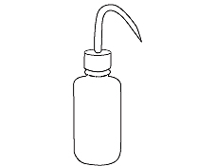
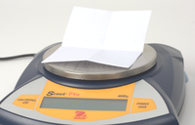
Evidence of a Chemical Reaction
Materials and Equipment
Collect all of these materials before beginning the lab.
Fast response temperature sensor
Hot plate
Graduated cylinder, 100-mL
Graduated cylinder, 10-mL
Beakers (2), 250-mL
Test tubes (7), 15-mm x 100-mm
Test tube rack
Wash bottle filled with distilled (deionized) water
Beaker for collecting waste rinse water
Test tube holder
Spatula
Stir rod
Balance
Weighing paper
250-mL
waste

Slide 12
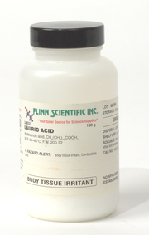
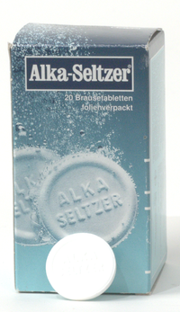
Evidence of a Chemical Reaction
...Materials and Equipment
Also collect these additional materials before starting.
White vinegar, 2 mL
Calcium carbonate, 0.2 g
1.0 M Citric acid solution, 2 mL
1.0 M Sodium bicarbonate solution, 2 mL
0.5 M Copper sulfate solution, 2 mL
1.0 M Sodium hydroxide solution, 2 mL
0.05 M Silver nitrate solution, 2 mL
0.1 M Sodium chloride solution, 2 mL
Lauric acid, 0.5 g
Colored drink powder, 0.2 g
Effervescent tablet
Water, 250 mL
Lauric acid
Efferv.
Tablets

Slide 13
Evidence of a Chemical Reaction
Sequencing Challenge
The steps to the left are part of the procedure for this lab activity. They are not in the right order. Determine the correct sequence of the steps, then take a snapshot of this page.
A. Classify the unknown changes as chemical reactions or physical changes based on your observations.
B. Perform 3 chemical reactions and 3 physical changes and enter the evidence of each type of change occurring.
C. Perform four unknown changes and record your observations.
D. Pour 150 mL of water into a 250- mL beaker and bring the water to a boil to use later in the lab.
Notes:
L6 – text box
[ The correct sequence of steps is … ]

Slide 14
Evidence of a Chemical Reaction
Setup: Chemical Reactions
Connect the fast response temperature sensor to your data collection system.
Fill a 250-mL beaker with approximately 150 mL of water. Place the beaker on a hotplate and allow the water to boil. The boiling water will be used in the next 2 sections.
Label a clean test tube “Reaction #1, " a second clean test tube "Reaction #2," and a third clean test tube "Reaction #3."
Add 2 mL of vinegar (acetic acid) to the test tube labeled “Reaction #1."
Insert the fast response temperature sensor into the vinegar.
Measure 0.2 g of calcium carbonate (powder) onto a piece of weighing paper.

Slide 15
Evidence of a Chemical Reaction
Q1: Enter at least two characteristics of vinegar into the data table.*
Q2: Enter at least two
characteristics of calcium
carbonate into the data
table.*
*To Enter Data into a Table:
Tap to open the tool palette.
Tap then tap a cell in the data table to highlight it in yellow.
Tap to open the Keyboard screen.
Notes:
L1245 – Table
col 1: [ Reactant #1 : vinegar, citric acid, copper (II) sulfate ]
col 3: [ Reactant #2 : calcium carbonate, sodium bicarbonate, sodium hydroxide ]

Slide 16
Evidence of a Chemical Reaction
Collect Data:
Tap to start collecting data.
Add 0.2 g of calcium carbonate into the vinegar and swirl test tube to mix.
Tap then to re-scale the graph so that you can clearly see the changes in temperature that are taking place.
Once the temperature has stabilized tap to stop collecting data.

Slide 17
Evidence of a Chemical Reaction
Q3: Describe the new product(s) formed when vinegar and calcium carbonate reacted.
Q4: Is the reaction between vinegar and calcium carbonate exothermic or endothermic? How do you know?
Q5: What evidence of a chemical reaction was observed when vinegar and calcium carbonate reacted?
Notes:
L4 – text box
[ The product(s) formed … ]
L5 – text box
[ The reaction is … ]
L6 – text box
[ The evidence of a chemical reaction was … ]

Slide 18
Evidence of a Chemical Reaction
Collect Data: Chemical Reactions
Remove the fast response temperature sensor from the "Reaction #1" test tube. Set the test tube aside for possible re-use of the chemicals later in the experiment.
Thoroughly clean the fast response temperature sensor by rinsing it several times with distilled water.
Add 2 mL of citric acid to the test tube labeled “Reaction #2.”
Insert the fast response temperature sensor into the citric acid.
Measure 2 mL of 1.0 M sodium bicarbonate solution and keep it in the graduated cylinder.

Slide 19
Evidence of a Chemical Reaction
Q6: Enter at least two characteristics of citric acid into the data table.*
Q7: Enter at least two characteristics of sodium bicarbonate into the data table.*
*To Enter Data into a Table:
Tap to open the tool palette.
Tap then tap a cell in the data table to highlight it in yellow.
Tap to open the Keyboard screen.
Notes:
L1245 – table
col 1: [ Reactant #1 : vinegar, citric acid, copper (II) sulfate ]
col 3: [ Reactant #2 : calcium carbonate, sodium bicarbonate, sodium hydroxide ]

Slide 20
Evidence of a Chemical Reaction
Collect Data
Tap to start collecting data.
Add 2 mL of sodium bicarbonate into the citric acid and swirl the test tube to mix.
Tap then to re-scale the graph to clearly see the changes taking place in temperature.
Once the temperature has stabilized tap to stop collecting data.

Slide 21
Evidence of a Chemical Reaction
Q8: Describe the new product(s) formed when citric acid and sodium bicarbonate reacted.
Q9: Is the reaction between citric acid and sodium bicarbonate exothermic or endothermic? How do you know?
Q10: What evidence of a chemical reaction was observed when citric acid and sodium bicarbonate reacted?
Notes:
L4 – text box
[ The product(s) formed … ]
L5 – text box
[ The reaction is … ]
L6 – text box
[ The evidence of a chemical reaction was … ]

Slide 22
Evidence of a Chemical Reaction
Collect Data: Chemical Reactions
Remove the fast response temperature sensor from the "Reaction #2" test tube. Set the test tube aside for possible re-use of the chemicals later in the experiment.
Thoroughly clean the fast response temperature sensor by rinsing it several times with distilled water.
Add 2 mL of copper(II) sulfate to the test tube labeled “Reaction #3.”
Insert the fast response temperature sensor into the copper(II) sulfate.
Measure 2 mL of 1.0 M sodium hydroxide solution and keep it in the graduated cylinder.

Slide 23
Evidence of a Chemical Reaction
Q11: Enter at least two characteristics of copper(II) sulfate into the data table.*
Q12: Enter at least two characteristics of sodium hydroxide into the data table.*
*To Enter Data into a Table:
Tap to open the tool palette.
Tap then tap a cell in the data table to highlight it in yellow.
Tap to open the Keyboard screen.
Notes:
L1245 – table
col 1: [ Reactant #1 : vinegar, citric acid, copper (II) sulfate ]
col 3: [ Reactant #2 : calcium carbonate, sodium bicarbonate, sodium hydroxide ]

Slide 24
Evidence of a Chemical Reaction
Tap to start collecting data.
Add 2 mL of sodium hydroxide into the copper(II) sulfate and swirl the test tube to mix.
Tap then to re-scale the graph to clearly see the changes taking place in temperature.
Once the temperature has stabilized tap to stop collecting data.

Slide 25
Evidence of a Chemical Reaction
Q13: Describe the new product(s) formed when copper(II) sulfate and sodium hydroxide reacted.
Q14: Is the reaction between copper(II) sulfate and sodium hydroxide exothermic or endothermic? How do you know?
Q15: What evidence of a chemical reaction was observed when copper(II) sulfate and sodium hydroxide reacted?
Notes:
L4 – text box
[ The product(s) formed … ]
L5 – text box
[ The reaction is … ]
L6 – text box
[ The evidence of a chemical reaction was … ]

Slide 26
Evidence of a Chemical Reaction
Q16: Colorless gasses cannot be “seen”. How is it possible to know if a gas is being evolved (created) in an aqueous solution?
Q17: What is a "reactant" in a chemical reaction?
Q18: What is a "product" in a chemical reaction?
Notes:
L4 – text box
[ A gas is being produced if … ]
L5 – text box
[ A reactant is … ]
L6 - text box
[ A product is … ]

Slide 27
Evidence of a Chemical Reaction
Setup: Physical Changes
Remove the fast response temperature sensor from the "reaction #3" test tube.
Set the test tube aside for possible re-use of the chemicals later in the experiment.
Thoroughly clean the fast response temperature sensor by rinsing it with distilled water.
Observe the water that you started heating at the beginning of the lab. Keep the water at a gentle boil because you'll use it to heat a chemical in the last part of this lab. You may need to add more water to replace water that is lost as steam.

Slide 28
Evidence of a Chemical Reaction
Collect Data:
Observe the water being heated and enter your observations of water before boiling and after in the data table.*
*To Enter Data into a Table:
Tap to open the tool palette.
Tap then tap a cell in the data table to highlight it in yellow.
Tap to open the Keyboard screen.
Notes:
L1245 – Table
col 1: [ Physical Change : Boil water, Dissolve colored drink in water, Break effervescent tablet into 3-4 pieces ]

Slide 29
Evidence of a Chemical Reaction
Add 0.2 g of a colored drink to a test tube labeled "physical change #2."
Add 5 mL of water to the test tube.
Enter your observations in the data table.*
*To Enter Data into a Table:
Tap to open the tool palette.
Tap then tap a cell in the data table to highlight it in yellow.
Tap to open the Keyboard screen.
Notes:
L1245 – Table
col 1: [ Physical Change : Boil water, Dissolve colored drink in water, Break effervescent tablet into 3-4 pieces ]

Slide 30
Evidence of a Chemical Reaction
Break an effervescent tablet into 3-4 pieces.
Enter your observations of the tablet before and after breaking it into the data table.*
Note: Save the broken tablet pieces. They will be used later
in the lab.
*To Enter Data into a Table:
Tap to open the tool palette.
Tap then tap a cell in the data table to highlight it in yellow.
Tap to open the Keyboard screen.
Notes:
L1245 – Table
col 1: [ Physical Change : Boil water, Dissolve colored drink in water, Break effervescent tablet into 3-4 pieces ]

Slide 31
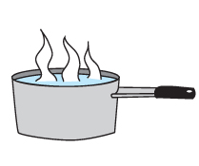
Evidence of a Chemical Reaction
Collect Data: Physical Changes
Q19: How are physical changes and chemical reactions different from each other?
Notes:
L456 – text box
[ Physical changes and chemical reactions are different … ]

Slide 32
Evidence of a Chemical Reaction
Setup: Unknown Changes
You are going to finish the lab by performing four unknown changes and determining whether the changes are physical changes or chemical reactions. To set up for these four changes:
Change #1: Pour 100 mL of tap water into a clean 250-mL beaker. You will add the pieces of the effervescent tablet to the water (but NOT yet!!).
Change #2: Pour 2 mL of 0.05 M silver nitrate solution into a test tube labeled "unknown #2." Measure 2 mL of 0.1 M sodium chloride and store it in the graduated cylinder.
Change #3: You will heat the copper(II) hydroxide precipitate formed in the test tube labeled "reaction #3" in the boiling water.
Change #4: Measure 0.5 g of lauric acid and place it in a test tube labeled "unknown #4." You will use the boiling water to heat the lauric acid.

Slide 33
Evidence of a Chemical Reaction
Q20: Enter at least two characteristics of each reactant in the four unknown changes that will be performed.*
Note: the reactant "heat" does not need to be described.
*To Enter Data into a Table:
Tap to open the tool palette.
Tap then tap a cell in the data table to highlight it in yellow.
Tap to open the Keyboard screen.
Notes:
L1245 – Table
col 1 : [ Starting Substance #1 : water, 0.05 M silver nitrate, Copper (II) hydroxide, Lauric acid ]
col 3 : [ Starting Substance #2 : Everescent tablet, 0.1 M sodium chloride, Heat, Heat ]

Slide 34
Evidence of a Chemical Reaction
Collect Data:
Place the temperature sensor in the 100 mL of water.
Tap to start collecting data.
Add the broken pieces of the effervescent tablet to the beaker and swirl to mix.
Tap then to re-scale the graph.
When the temperature has stabilized tap to stop collecting data.

Slide 35
Evidence of a Chemical Reaction
Q21: Enter at least two observations when the tablet pieces were mixed with water.*
Q22: Was a new chemical substance formed (yes or no)?*
*To Enter Data into a Table:
Tap to open the tool palette.
Tap then tap a cell in the data table to highlight it in yellow.
Tap to open the Keyboard screen.
Notes:
L1245 – Table
col 1 : [ Starting Substance #1 : Water, 0.05 M silver nitrate, Copper (II) hydroxide, Lauric acid ]
col 2 : [ Starting Substance #2 : Evervescent tablet, 0.1 M sodium chloride, Heat, Heat ]

Slide 36
Evidence of a Chemical Reaction
Clean the temperature sensor and place it in the 2 mL of silver nitrate solution in the "unknown #2" test tube.
Tap to start collecting data.
Pour the 2 mL of sodium chloride solution into the sodium chloride (in test tube "unknown #2").
Tap then to re-scale the graph.
When the temperature has stabilized tap to stop collecting data.

Slide 37
Evidence of a Chemical Reaction
Q23: Enter at least two observations when the silver nitrate and sodium chloride were mixed.*
Q24: Was a new chemical substance formed (yes or no)?*
*To Enter Data into a Table:
Tap to open the tool palette.
Tap then tap a cell in the data table to highlight it in yellow.
Tap to open the Keyboard screen.
Notes:
L1245 – Table
col 1 : [ Starting Substance #1 : Water, 0.05 M silver nitrate, Copper (II) hydroxide, Lauric acid ]
col 2 : [ Starting Substance #2 : Evervescent tablet, 0.1 M sodium chloride, Heat, Heat ]

Slide 38
Evidence of a Chemical Reaction
Collect Data: Unknown Changes
1. Using a test tube holder, place the test tube labeled "chemical reaction #3" (which contains the copper(II) hydroxide precipitate) into the boiling water.
Using a second test tube holder, place the test tube labeled "unknown #4 (containing lauric acid) into the boiling water.
Allow the test tubes to sit in the boiling water until they have completely changed (about 3-5 minutes).
When the changes have occurred, remove the test tubes from the boiling water using the test tube holder and place them in the test tube rack to cool.
Turn off the hot plate and allow it to cool before cleaning up!
Caution: make sure the test tubes are pointed away from people!

Slide 39
Evidence of a Chemical Reaction
Q25: Enter at least two observations you made when heating each substance. *
Q26: Was a new chemical substance formed in either case (yes or no)? *
*To Enter Data into a Table:
Tap to open the tool palette.
Tap then tap a cell in the data table to highlight it in yellow.
Tap to open the Keyboard screen.
Notes:
L1245 – Table
col 1 : [ Starting Substance #1 : Water, 0.05 M silver nitrate, Copper (II) hydroxide, Lauric acid ]
col 2 : [ Starting Substance #2 : Evervescent tablet, 0.1 M sodium chloride, Heat, Heat ]

Slide 40
Evidence of a Chemical Reaction
Analysis
Identify each unknown change as a physical change or a chemical reaction and enter the evidence you used to make your decision.
*To Enter Data into a Table:
Tap to open the tool palette.
Tap then tap a cell in the data table to highlight it in yellow.
Tap to open the Keyboard screen.
Notes:
L1245 – Table
col 1 : [ Unknown Change : Effervescent tablet and water, Silver nitrate and sodium chloride, Heating copper (II) sulfate, Heating Lauric acid ]

Slide 41
Evidence of a Chemical Reaction
Analysis
Were unknown changes #1 and #2 exothermic or endothermic?
Run 4: unknown #1
Run 5: unknown #2
Notes:
L6 – text box
[ Unknown change #1 was … ]
[ Unknown change #2 was … ]

Slide 42
Evidence of a Chemical Reaction
Analysis
Were unknown change #3 and unknown change #4 exothermic or endothermic? Explain your reasoning.
Notes:
L456 – text box
[ Unknown change #3 and #4 were … ]

Slide 43
Evidence of a Chemical Reaction
Analysis
What is the difference between a physical change and a chemical reaction?
Notes:
L456 – text box
[ A physical change … ]
[ A chemical reaction … ]

Slide 44
Evidence of a Chemical Reaction
Analysis
What are the four main types of evidence that indicate a chemical reaction has occurred?
Notes:
L456 – text box
[ The four types of evidence indicating a chemical reaction are … ]

Slide 45
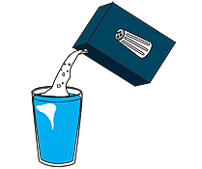
Evidence of a Chemical Reaction
Synthesis
If salt is mixed with water, is this an example of a physical change or chemical reaction? Explain your reasoning.
Notes:
L456 – text box
[ Salt and water mixing is an example of a … ]

Slide 46
Evidence of a Chemical Reaction
Synthesis
List two examples in which a temperature change occurs, but no new substance is formed.
Notes:
L456 – text box
[ A temperature change occurs, but no new substances is formed when … ]

Slide 47
Evidence of a Chemical Reaction
Synthesis
When a nail becomes rusty, is this an example of a physical change or a chemical reaction? Explain your reasoning.
Notes:
L456 – text box
[ A nail becoming rusty is … ]

Slide 48
Evidence of a Chemical Reaction
Synthesis
When grass grows, is this an example of a physical change or a chemical reaction? Explain your reasoning.
Notes:
L456 – text box
[ Grass growing involves … ]

Slide 49
Evidence of a Chemical Reaction
Synthesis
When a can of soda is opened, is this an example of a physical change or a chemical reaction? Explain your reasoning.
Notes:
L456 – text box
[ Opening a soda can is a … ]

Slide 50
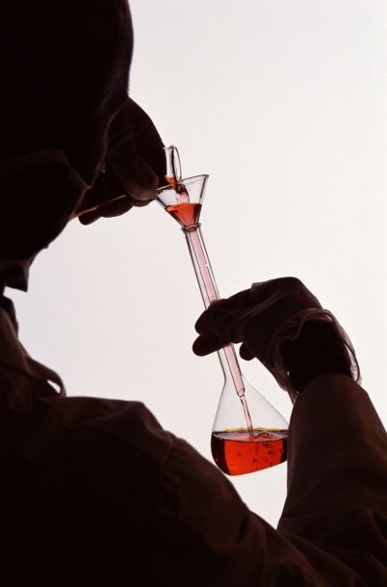
Evidence of a Chemical Reaction
Multiple Choice
In all chemical reactions, __________ turn into ___________.
products; reactants
molecules; atoms
reactants; products
atoms; elements
Notes:
L6 – text box
[ The best choice is … ]

Slide 51
Evidence of a Chemical Reaction
Multiple Choice
The burning of wood to form soot is an example of a ______________ change.
Physical
Slow
Fast
chemical
Notes:
L6 – text box
[ The best choice is … ]

Slide 52
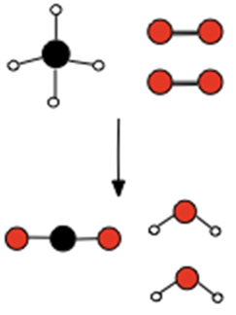
Evidence of a Chemical Reaction
Multiple Choice
Which of the following indicate a chemical reaction has occurred?
The change is very fast.
A precipitate forms.
My lab partner said so.
The state of matter changes.
A dark orange solution turns light orange.
Notes:
L6 – text box
[ The best choice is … ]

Slide 53
Evidence of a Chemical Reaction
Multiple Choice
A chemical reaction that absorbs energy is called a(n) _____________ reaction.
endothermic
exothermic
balanced
complete
Notes:
L6 – text box
[ The best choice is … ]

Slide 54
Evidence of a Chemical Reaction
Multiple Choice
Grinding a large crystal of rock candy into small pieces is an example of a ___________.
physical change
seriously tedious chore
chemical change
exothermic change
endothermic change
Notes:
L6 – text box
[ The best choice is … ]

Slide 55
Evidence of a Chemical Reaction
Congratulations!
You have completed the lab.
Please remember to follow your teacher's instructions for cleaning-up and submitting your lab.
Notes:
Color scheme (RGB values)
biology 121, 173, 54
chemistry 0 176, 216
physics 0, 102, 204
earth 204, 102, 0
middle 153, 102, 153
elementary 255, 51, 0

Slide 56
Evidence of a Chemical Reaction
References
All images were taken from PASCO documentation, public domain clip art, or Wikimedia Foundation Commons.
TEST TUBE & LADY http://commons.wikimedia.org/wiki/File:Test_tube_(PSF).svg
SUCROSE http://commons.wikimedia.org/wiki/File:Sucrose-3D-balls.png
BURNING MATCH http://freeclipartnow.com/construction/tools/lit-match.jpg.html
WATER MOLECULE http://commons.wikimedia.org/wiki/File:Water_molecule.svg
CUP WITH GAS http://www.freeclipartnow.com/food/beverages/soda/soft-drink-icon.jpg.html
THERMOMETER http://www.freeclipartnow.com/small-icons/miscellaneous/thermometer-1.jpg.html
NITRATE STAIN http://commons.wikimedia.org/wiki/File:Silver_nitrate_stains.jpg
HOT WARNING http://commons.wikimedia.org/wiki/File:DIN_4844-2_Warnung_vor_heisser_Oberflaeche_D-W026.svg
VINEGAR http://freeclipartnow.com/household/chores/cleaners/vinegar.jpg.html
BEAKER http://freeclipartnow.com/science/flasks-tubes/beaker.jpg.html
NAIL http://commons.wikimedia.org/wiki/File:Nail.JPG
SODA CAN http://www.freeclipartnow.com/food/beverages/soda/pop-can.jpg.html
BURNING WOOD http://commons.wikimedia.org/wiki/File:NaturalFireplace.jpg

